Slide 1

Chapter 11
Data Link Control

Slide 2
11.1 FRAMING
The data link layer needs to pack bits into frames, so that each frame is distinguishable from another. Our postal system practices a type of framing. The simple act of inserting a letter into an envelope separates one piece of information from another; the envelope serves as the delimiter.
Topics discussed in this section:
Fixed-Size Framing Variable-Size Framing

Slide 3
Framing
Fixed-Size Framing
There is no need for defining the boundaries of the frame.
The size itself can be used as a delimiter.
Example: ATM WAN.
Variable-Size Framing
Character-Oriented (or byte-oriented) Protocols
Data to be carried are 8-bit characters from a coding system.
Bit-Oriented Protocols
The data section of a frame is a sequence of bits to be interpreted by the upper layer as text, graphic, audio, video, and so on.

Slide 4
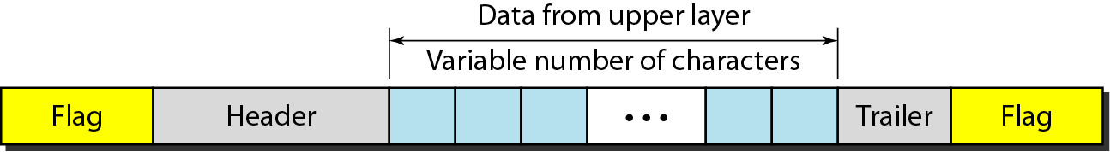
Framing
Character-Oriented Protocols
To separate one frame from the next, an 8-bit(1 byte) flag, composed of protocol-dependent special characters, is added at the beginning and the end of a frame.
Figure 11.1 A frame in a character-oriented protocol

Slide 5
Framing
Character-Oriented Protocols
Any pattern used for the flag could also be part of the information.
To fix this problem, a byte-stuffing strategy was added to character-oriented framings.
Byte stuffing is the process of adding 1 extra byte (ESC-predefined bit pattern) whenever there is a flag or escape character in the text.

Slide 6
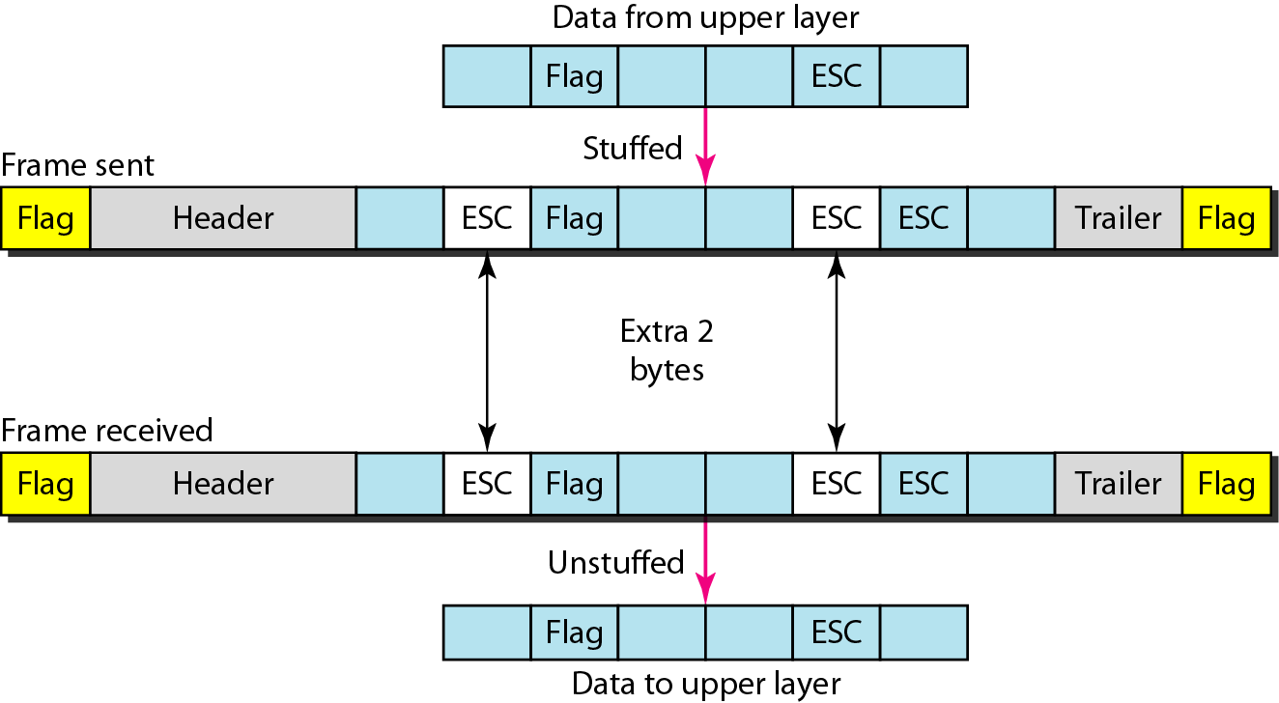
Character-Oriented Protocols
Whenever the receiver encounters the ESC character, receiver removes it from the data section and treats the next character as data, not a delimiting flag.
The escape characters (ESC) that are part of the text must also be marked by another escape character (ESC).
Figure 11.2 Byte stuffing and unstuffing

Slide 7
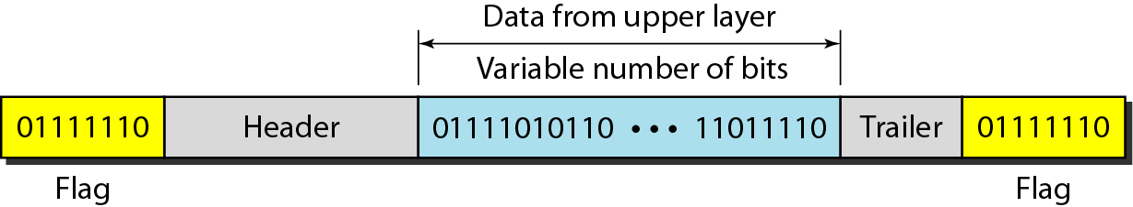
Bit-Oriented Protocols
Bit-Oriented Protocols
Most protocols use a special 8-bit pattern flag 01111110 as the delimiter to define the beginning and the end of the frame.
Figure 11.3 A frame in a bit-oriented protocol

Slide 8
Bit-Oriented Protocols
This flag can create the same problem in the byte-oriented protocol.
We do this by stuffing 1 single bit (instead of 1 byte) to prevent the pattern from looking like a flag. The strategy is called Bit Stuffing.
Bit stuffing is the process of adding one extra 0 whenever five consecutive 1s follow a 0 in the data, so that the receiver does not mistake the pattern 0111110 for a flag.
This extra stuffed bit is removed from the data by the receiver

Slide 9
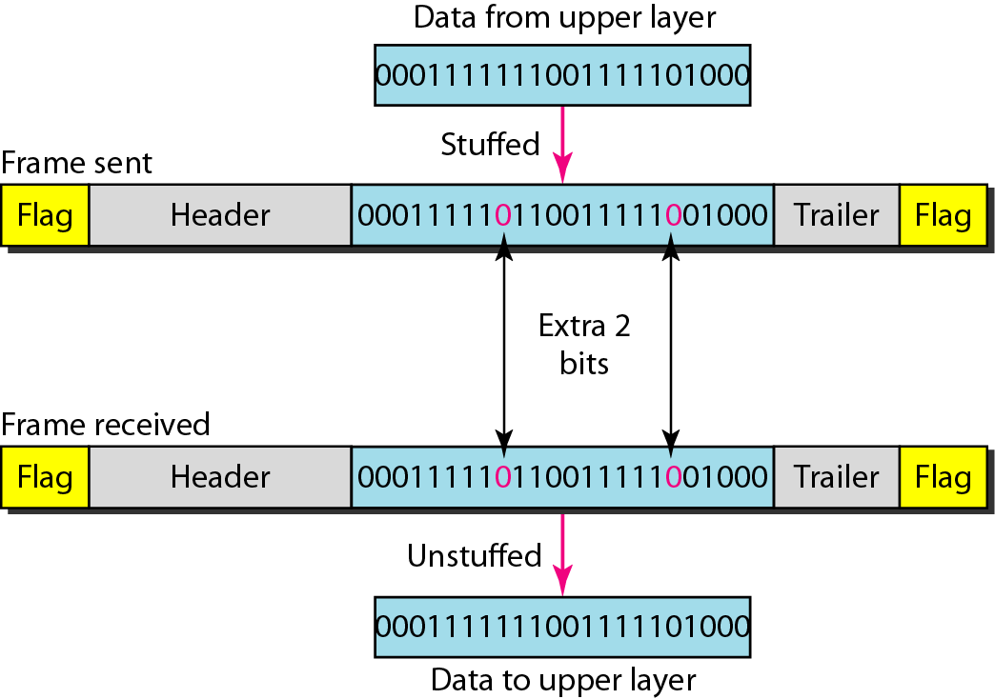
Bit-Oriented Protocols
Figure 11.4 Bit stuffing and unstuffing

Slide 10
11.2 FLOW AND ERROR CONTROL
The most important responsibilities of the data link layer are flow control and error control. Collectively, these functions are known as data link control.
Topics discussed in this section:
Flow Control Error Control

Slide 11
Flow Control
Flow control refers to a set of procedures used to restrict the amount of data that the sender can send before waiting for acknowledgment.
Flow control is the regulation of the sender’s data rate so that the receiver buffer does not become overwhelmed.

Slide 12
Error Control
Error control in the data link layer is based on automatic repeat request, which is the retransmission of data.
Error control is both error detection and error correction.
Basic Error Control Methods in Data Link Layer:
Added CRC in sender side and Checked by the Receiver.
Two Approaches:
No Acknowledgment: (used in wired LANs like Ethernet)
If corrupted silently discarded, else delivered to network layer.
With Acknowledgment:
Receiver sends ACK for valid frames (supports both flow & error control).

Slide 13
11.3 PROTOCOLS
Now let us see how the data link layer can combine framing, flow control, and error control to achieve the delivery of data from one node to another.
The protocols are normally implemented in software by using one of the common programming languages. To make our discussions language-free, we have written in pseudocode a version of each protocol that concentrates mostly on the procedure instead of delving into the details of language rules.

Slide 14
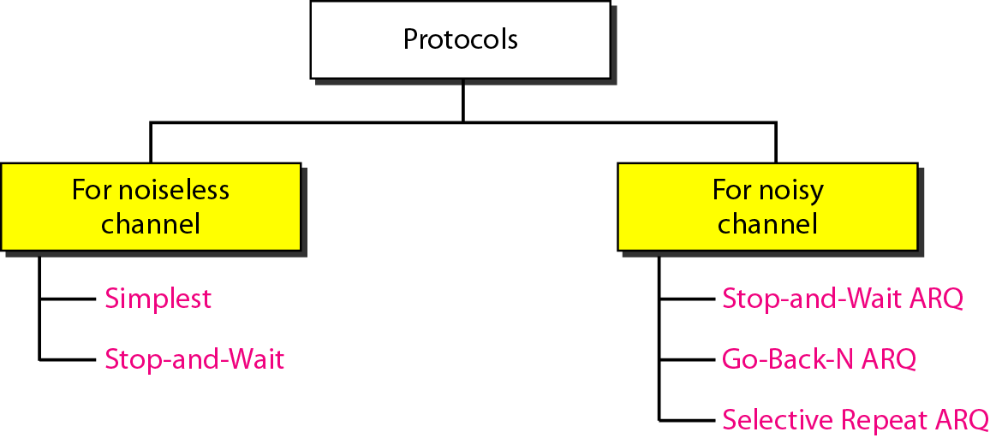
Protocols
Figure 11.5 Taxonomy of protocols discussed in this chapter (4th Ed.)

Slide 15
11.4 NOISELESS CHANNELS
Let us first assume we have an ideal channel in which no frames are lost, duplicated, or corrupted. We introduce two protocols for this type of channel.
Topics discussed in this section:
Simplest Protocol Stop-and-Wait Protocol

Slide 16
Simplest Protocol
Simplest Protocol has no flow and error control.
This protocol is a unidirectional protocol in which data frames are traveling in only one direction from the sender to receiver.
We assume that the receiver can immediately handle any frame it receives with a processing time that is small enough to be negligible.
In other words, the receiver can never be overwhelmed with incoming frames.

Slide 17
Simplest Protocol
There is no need for flow control in this scheme.
The data link layers of the sender and receiver provide transmission services for their network layers and use the services provided by their physical layers.
The sender sites cannot send a frame until its network layer has data packet to send.
The receiver sites cannot deliver a data packet to its network layer until a frame arrives.
If the protocol is implemented as a procedure, we need to introduce the idea of events in the protocol.

Slide 18
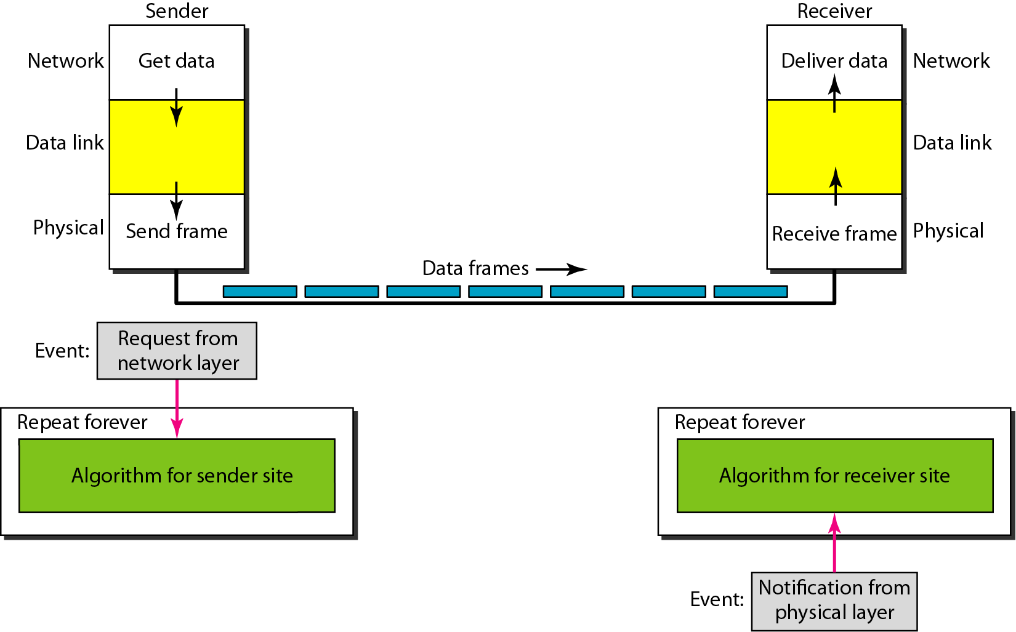
Simple/Simplest Protocol
Figure 11.6 The design of the simplest protocol with no flow or error control

Slide 19
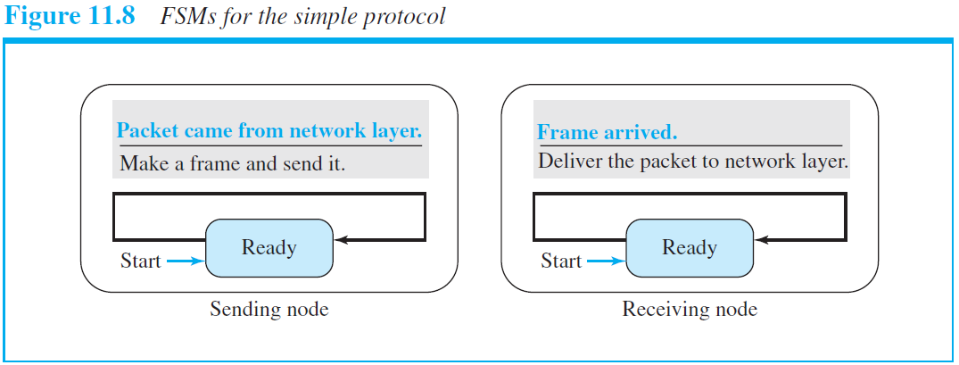
Simple/Simplest Protocol

Slide 20
Simplest Protocol
Algorithm 11.1 Sender-site algorithm for the simplest protocol

Slide 21
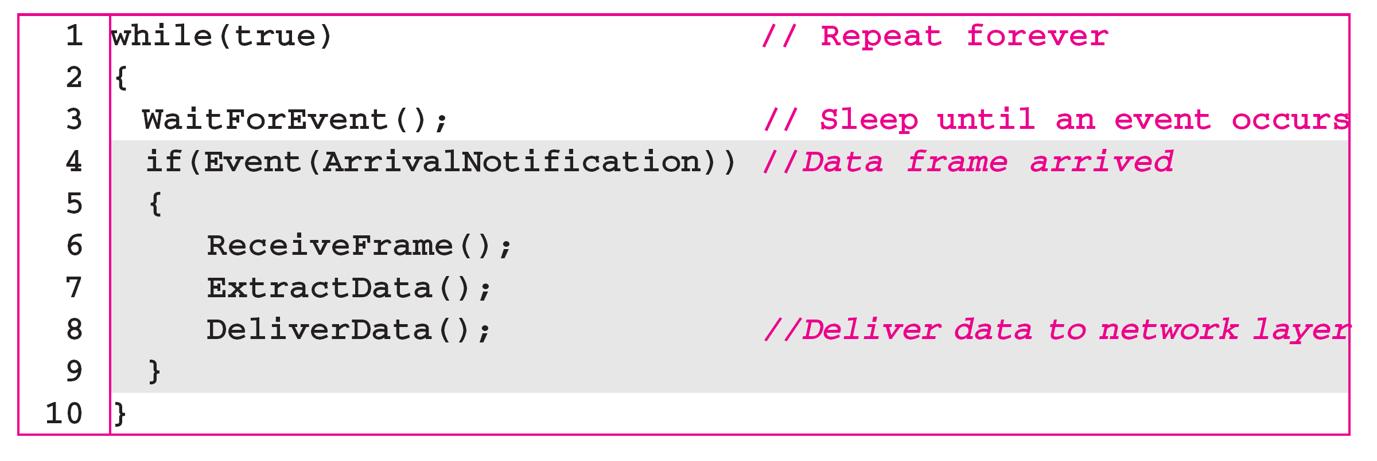
Simplest Protocol
Algorithm 11.2 Receiver-site algorithm for the simplest protocol

Slide 22
Simplest Protocol
Example 11.1
Figure 11.7 shows an example of communication using this protocol. It is very simple. The sender sends a sequence of frames without even thinking about the receiver. To send three frames, three events occur at the sender site and three events at the receiver site. Note that the data frames are shown by tilted boxes; the height of the box defines the transmission time difference between the first bit and the last bit in the frame.

Slide 23
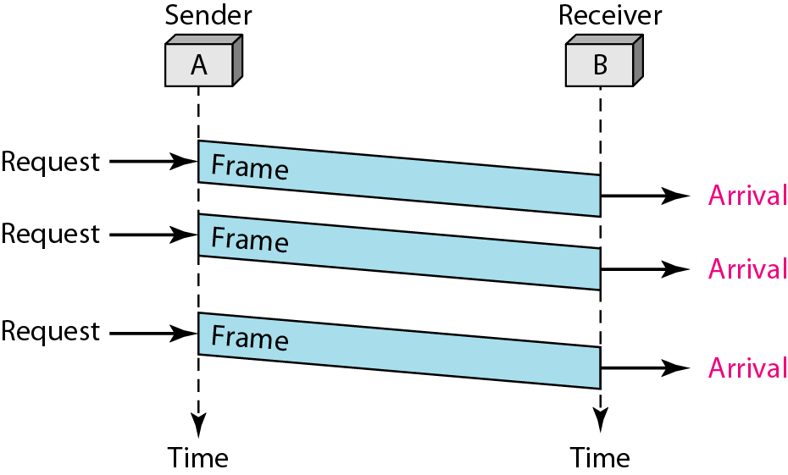
Simplest Protocol
Figure 11.7 Flow diagram for Example 11.1 (4th Ed.)

Slide 24
Stop and Wait Protocol
Stop and Wait Protocol
To prevent the receiver from becoming overwhelmed with frames, we somehow need to tell the sender to slow down.
We add flow control to the simplest protocol.
The sender sends a frame and waits for acknowledgment from the receiver before sending the next frame.
We still have unidirectional communication for data frames, but auxiliary ACK frames travel from the other direction.

Slide 25
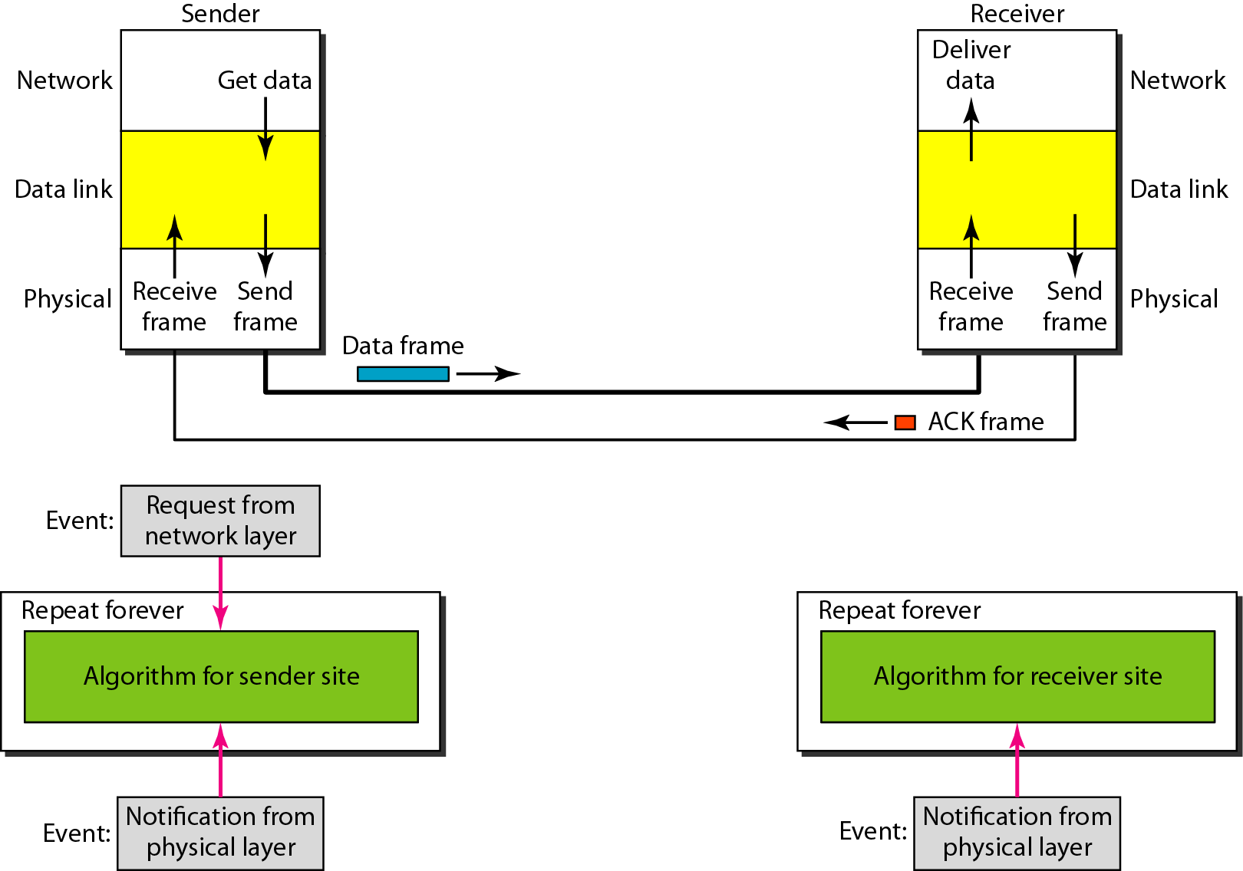
Stop and Wait Protocol
Figure 11.8 Design of Stop-and-Wait Protocol (4th Ed.)

Slide 26
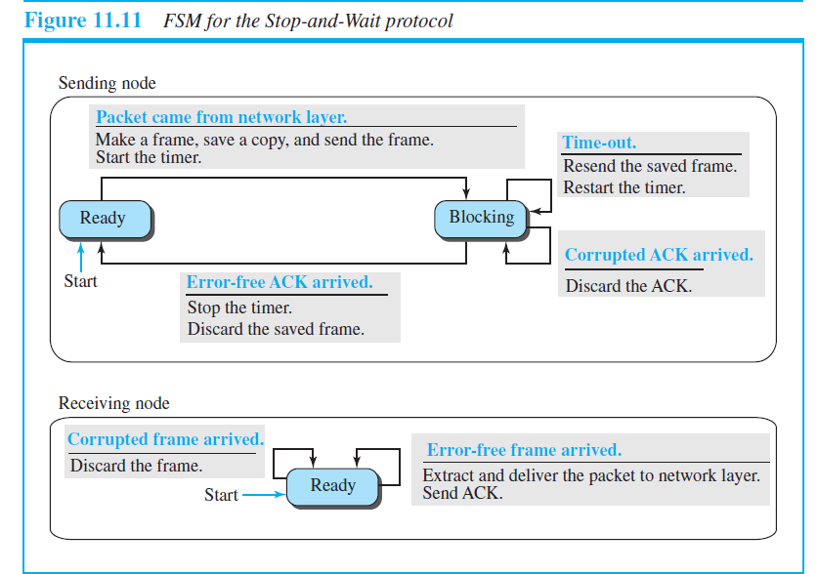
Stop and Wait Protocol

Slide 27
Stop and Wait Protocol
Algorithm 11.3 Sender-site algorithm for Stop-and-Wait Protocol

Slide 28
Stop and Wait Protocol
Algorithm 11.4 Receiver-site algorithm for Stop-and-Wait Protocol

Slide 29
Stop and Wait Protocol
Example 11.2 (4th Ed.)
Figure 11.9 shows an example of communication using this protocol. It is still very simple. The sender sends one frame and waits for feedback from the receiver. When the ACK arrives, the sender sends the next frame. Note that sending two frames in the protocol involves the sender in four events and the receiver in two events.

Slide 30
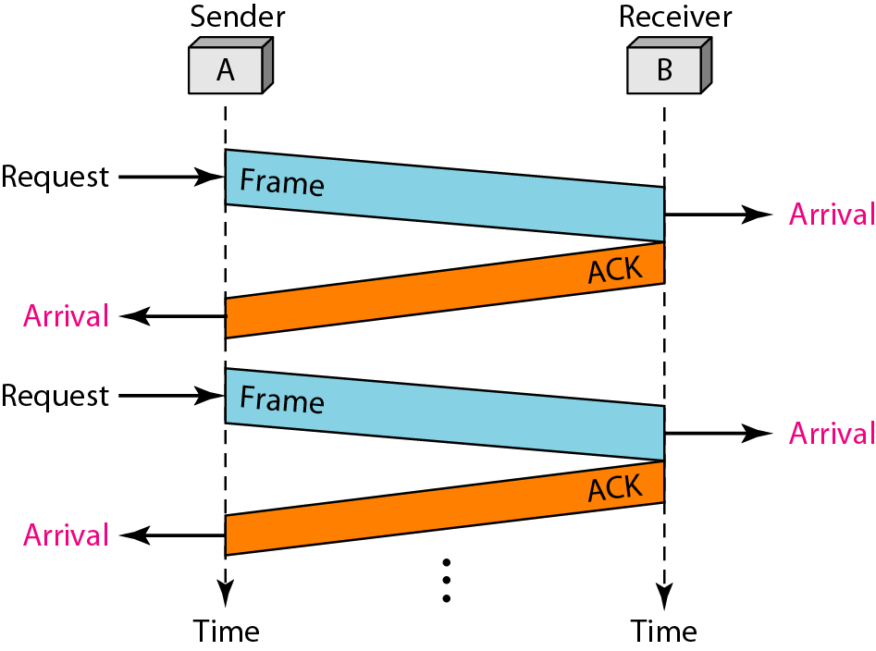
Stop and Wait Protocol
Figure 11.9 Flow diagram for Example 11.2 (4th Ed.)

Slide 31
11.5 NOISY CHANNELS
Although the Stop-and-Wait Protocol gives us an idea of how to add flow control to its predecessor, noiseless channels are nonexistent. We discuss three protocols in this section that use error control.
Topics discussed in this section:
Stop-and-Wait Automatic Repeat Request Go-Back-N Automatic Repeat Request Selective Repeat Automatic Repeat Request

Slide 32
Stop and Wait ARQ
Stop and wait ARQ adds a simple error control mechanism to the Stop and Wait Protocol.
Error correction in Stop-and-Wait ARQ is done by keeping a copy of the sent frame and retransmitting of the frame when the timer expires.
We use sequence numbers to number the frames. The sequence numbers are based on modulo-2 arithmetic.
Sequence Number : 0 ~ 2^{m} -1, and then repeated
The frame arrives safe and sound at the receiver; need to be sent an acknowledgment, and the corrupted and lost frames need to be resent.
The acknowledgment number always announces in modulo-2 arithmetic the sequence number of the next frame expected. (x + 1)

Slide 33
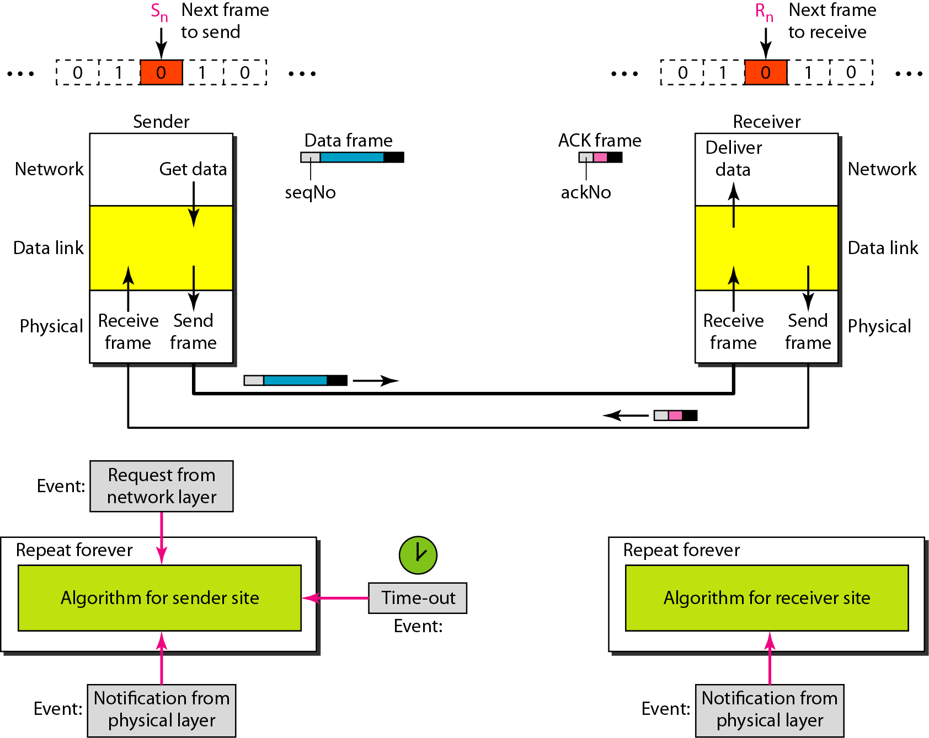
Stop and Wait ARQ
Figure 11.10 Design of the Stop-and-Wait ARQ Protocol

Slide 34
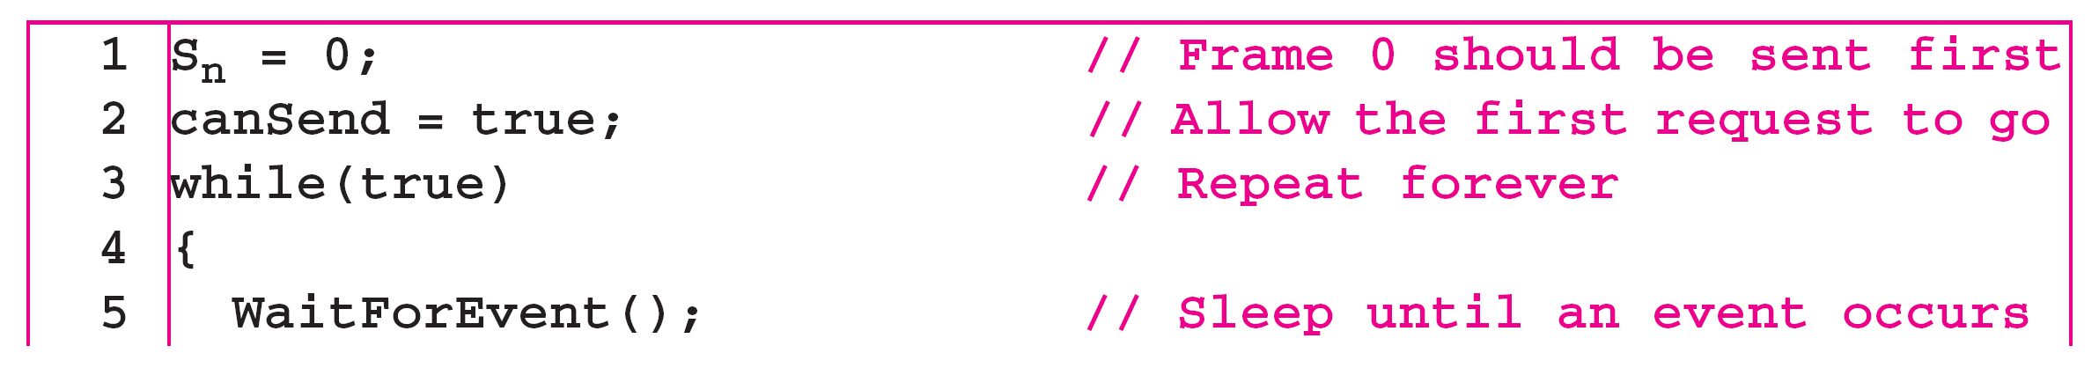
Stop and Wait ARQ
Algorithm 11.5 Sender-site algorithm for Stop-and-Wait ARQ
_{(continued)}

Slide 35
Stop and Wait ARQ
Algorithm 11.5 Sender-site algorithm for Stop-and-Wait ARQ
_{(continued)}

Slide 36
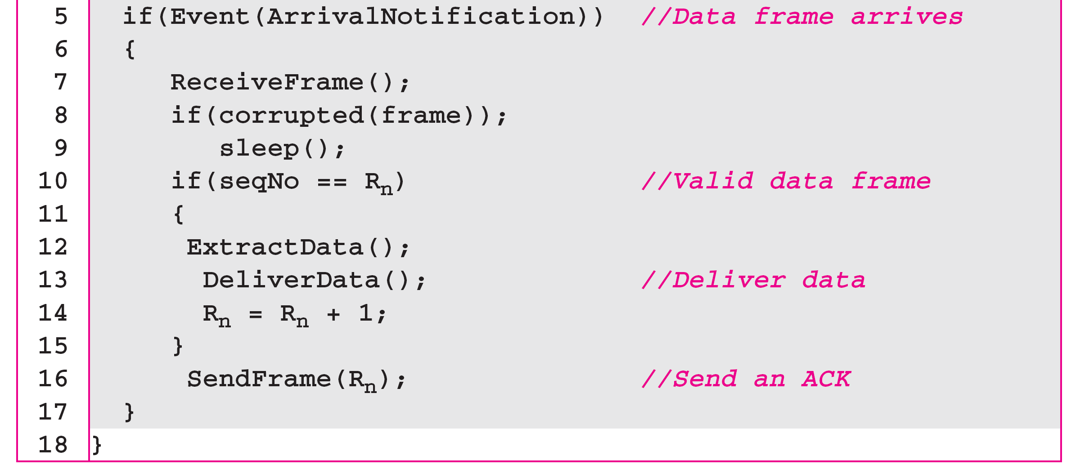
Stop and Wait ARQ
Algorithm 11.6 Receiver-site algorithm for Stop-and-Wait ARQ Protocol

Slide 37
Stop and Wait ARQ
Example 11.3 (4th Ed.)
Figure 11.11 shows an example of Stop-and-Wait ARQ. Frame 0 is sent and acknowledged. Frame 1 is lost and resent after the time-out. The resent frame 1 is acknowledged and the timer stops. Frame 0 is sent and acknowledged, but the acknowledgment is lost. The sender has no idea if the frame or the acknowledgment is lost, so after the time-out, it resends frame 0, which is acknowledged.

Slide 38
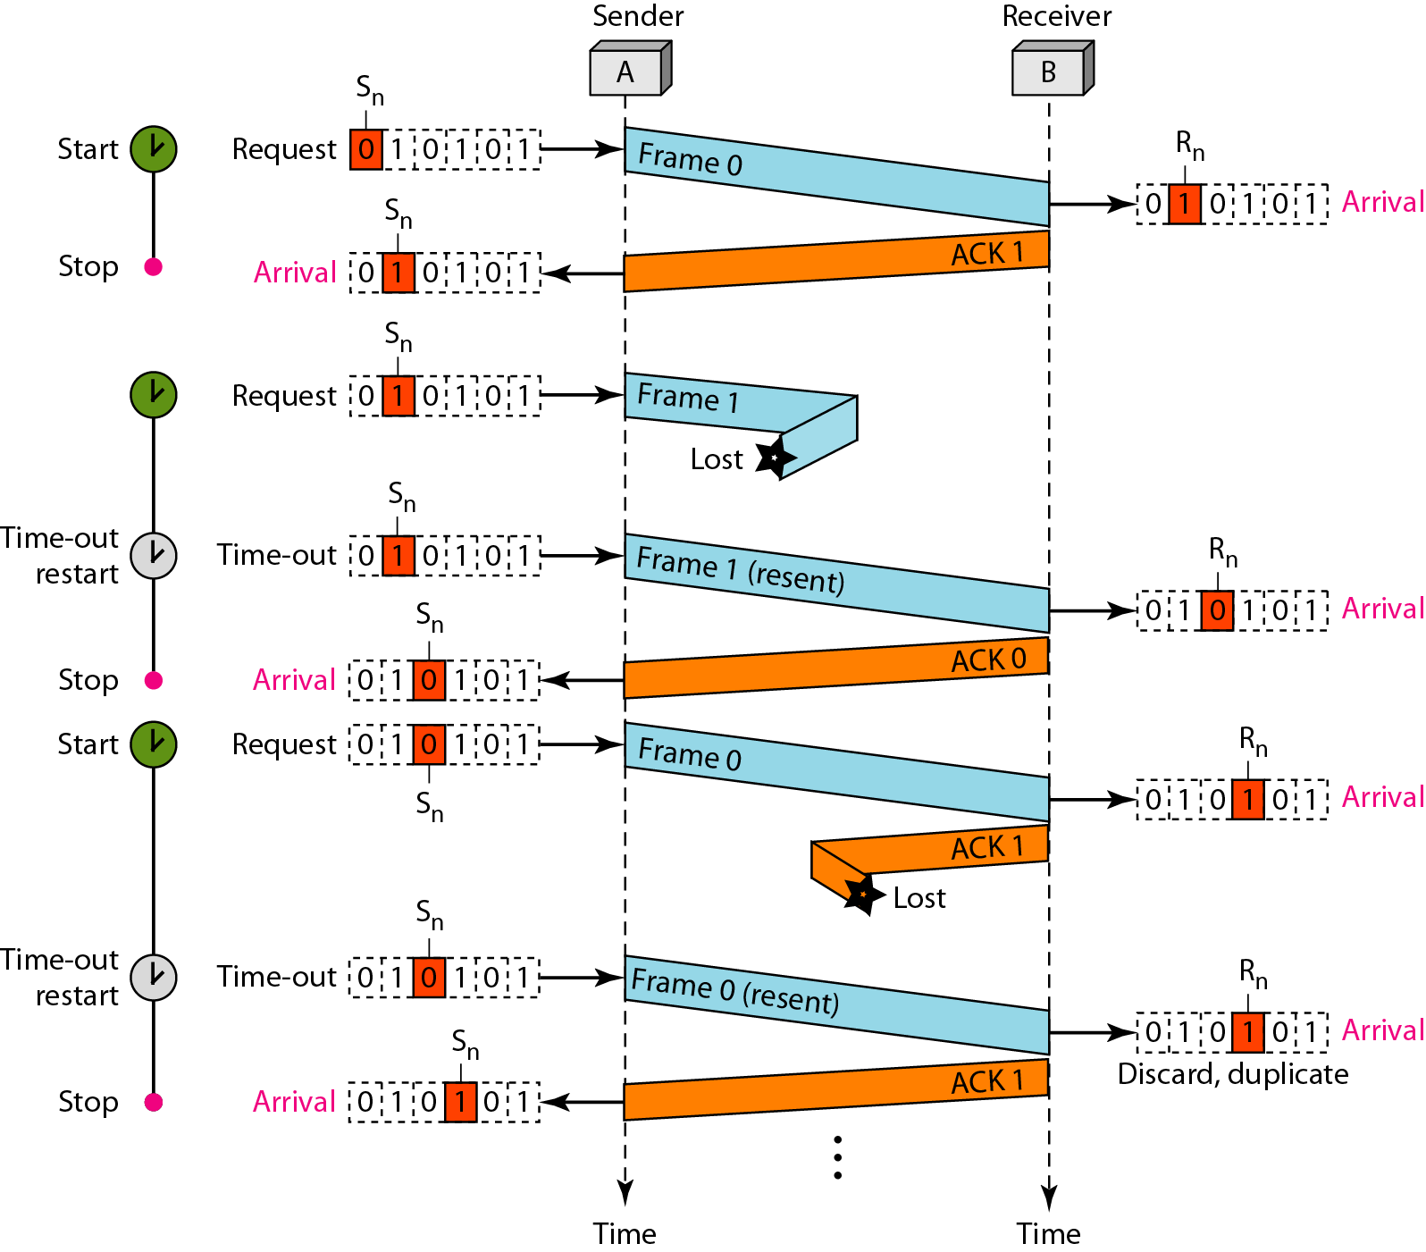
Stop and Wait ARQ
Figure 11.11 Flow diagram for Example 11.3 (4th Ed.)

Slide 39
Bandwidth-delay product
Bandwidth-delay product is a measure of the number of bits we can send out of our system while waiting for news from the receiver.
Bandwidth-delay product = Bandwidth x delay time
Utilization % of the link = (frame length / Bandwidth-delay
product) x 100

Slide 40
Stop and Wait ARQ
Example 11.4
Assume that, in a Stop-and-Wait ARQ system, the bandwidth of the line is 1 Mbps, and 1 bit takes 20 ms to make a round trip. What is the bandwidth-delay product? If the system data frames are 1000 bits in length, what is the utilization percentage of the link?
Solution
The bandwidth-delay product is

Slide 41
Stop and Wait ARQ
Example 11.4 (continued) (4th Ed.)
The system can send 20,000 bits during the time it takes for the data to go from the sender to the receiver and then back again. However, the system sends only 1000 bits. We can say that the link utilization is only 1000/20,000, or 5 percent. For this reason, for a link with a high bandwidth or long delay, the use of Stop-and-Wait ARQ wastes the capacity of the link.

Slide 42
Stop and Wait ARQ
Example 11.5
What is the utilization percentage of the link in Example 11.4 if we have a protocol that can send up to 15 frames before stopping and worrying about the acknowledgments?
Solution
The bandwidth-delay product is still 20,000 bits. The system can send up to 15 frames or 15,000 bits during a round trip. This means the utilization is 15,000/20,000, or 75 percent. Of course, if there are damaged frames, the utilization percentage is much less because frames have to be resent.

Slide 43
pipelining
In networking and in other areas, a task is often begun before the previous task has ended. - This is known as Pipelining.
There is no pipelining in stop-and-wait ARQ
Pipelining does apply to Go-Back-N ARQ and Selective Repeat ARQ
Pipelining improves the efficiency of the transmission if the number of bits in transition is large with respect to the bandwidth delay product.

Slide 44
Go-Back-N ARQ
In Go-Back-N ARQ, we can send several frames before receiving acknowledgement; we keep a copy of these frames until the acknowledgments arrive.
Sequence Numbers
Frames from a sending station are numbered sequentially.
m-bits for the sequence number : range repeat from 0 to 2^{m}-1.
0,1,2,3,4,5,6,7,8,9,10,11,12,13,14,15, 0,1,2,3,4,5,6,7,8,9,10,11,…..
modulo-2^{m}

Slide 45
Go-Back-N ARQ
Sliding window
is an abstract concept that defines the range of sequence numbers that is the concern of the sender and receiver.
Send Sliding Window
The send window is an abstract concept defining an imaginary box of size 2^{m} − 1 with three variables: S_{f}, S_{n}, and S_{size}.
The send window can slide one or more slots when a valid acknowledgment arrives.

Slide 46
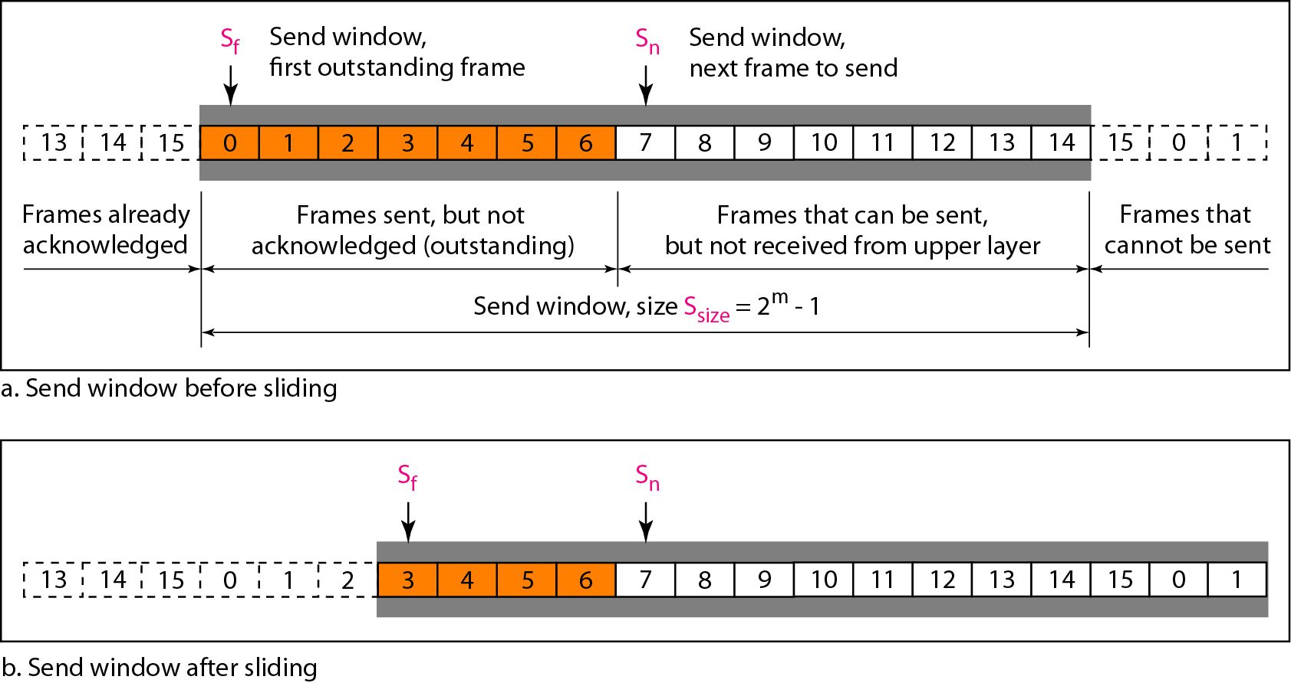
Go-Back-N ARQ
Figure 11.12 Send window for Go-Back-N ARQ

Slide 47
Go-Back-N ARQ
Receive Sliding Window
The receive window is an abstract concept defining an imaginary box of size 1 with one single variable R_{n}.
The window slides when a correct frame has arrived; sliding occurs one slot at a time.
Any frame arriving out of order is discarded and needs to be resent.

Slide 48
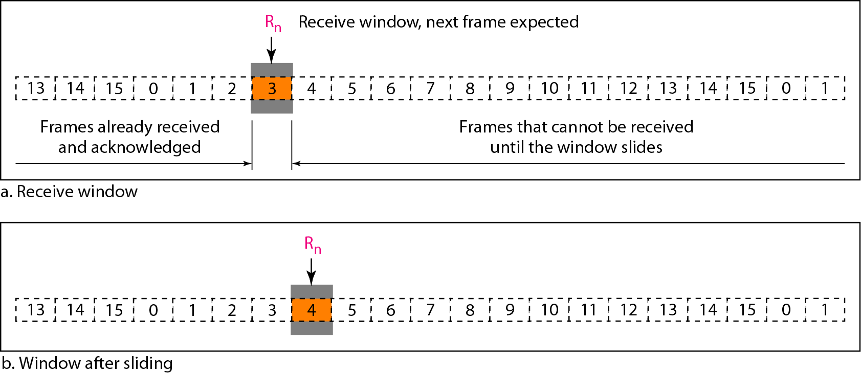
Go-Back-N ARQ
Figure 11.13 Receive window for Go-Back-N ARQ

Slide 49
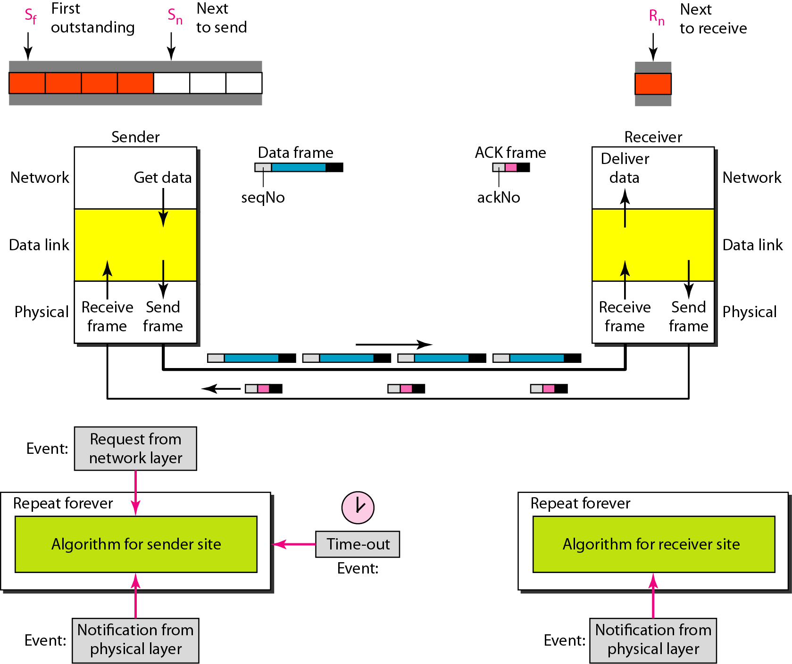
Go-Back-N ARQ
Figure 11.14 Design of Go-Back-N ARQ

Slide 50
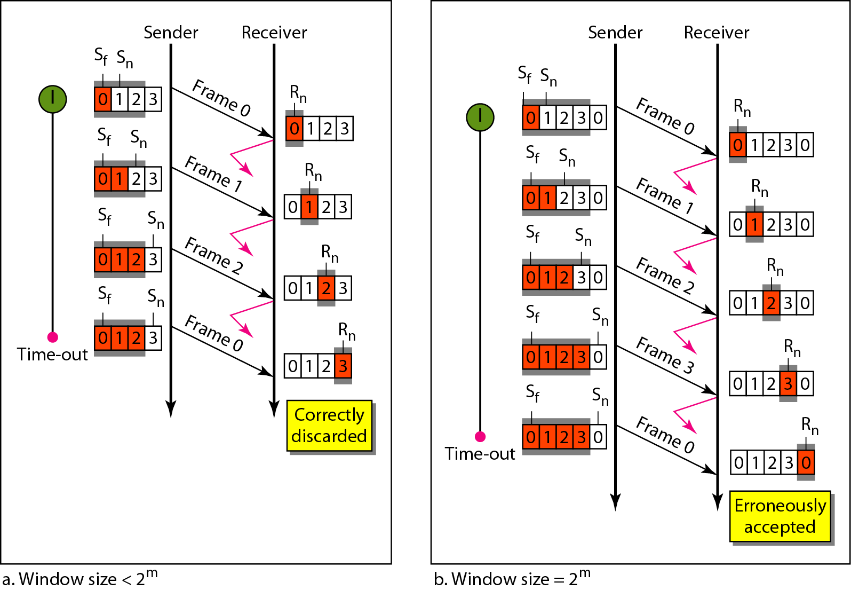
Go-Back-N ARQ
Figure 11.15 Window size for Go-Back-N ARQ

Slide 51

Go-Back-N ARQ
Note
In Go-Back-N ARQ, the size of the send window must be less than 2^{m};
the size of the receiver window is always 1.

Slide 52
Go-Back-N ARQ
Example 11.6 (4th Ed.)
Figure 11.16 shows an example of Go-Back-N. This is an example of a case where the forward channel is reliable, but the reverse is not. No data frames are lost, but some ACKs are delayed and one is lost. The example also shows how cumulative acknowledgments can help if acknowledgments are delayed or lost. After initialization, there are seven sender events. Request events are triggered by data from the network layer; arrival events are triggered by acknowledgments from the physical layer. There is no time-out event here because all outstanding frames are acknowledged before the timer expires. Note that although ACK 2 is lost, ACK 3 serves as both ACK 2 and ACK 3.

Slide 53
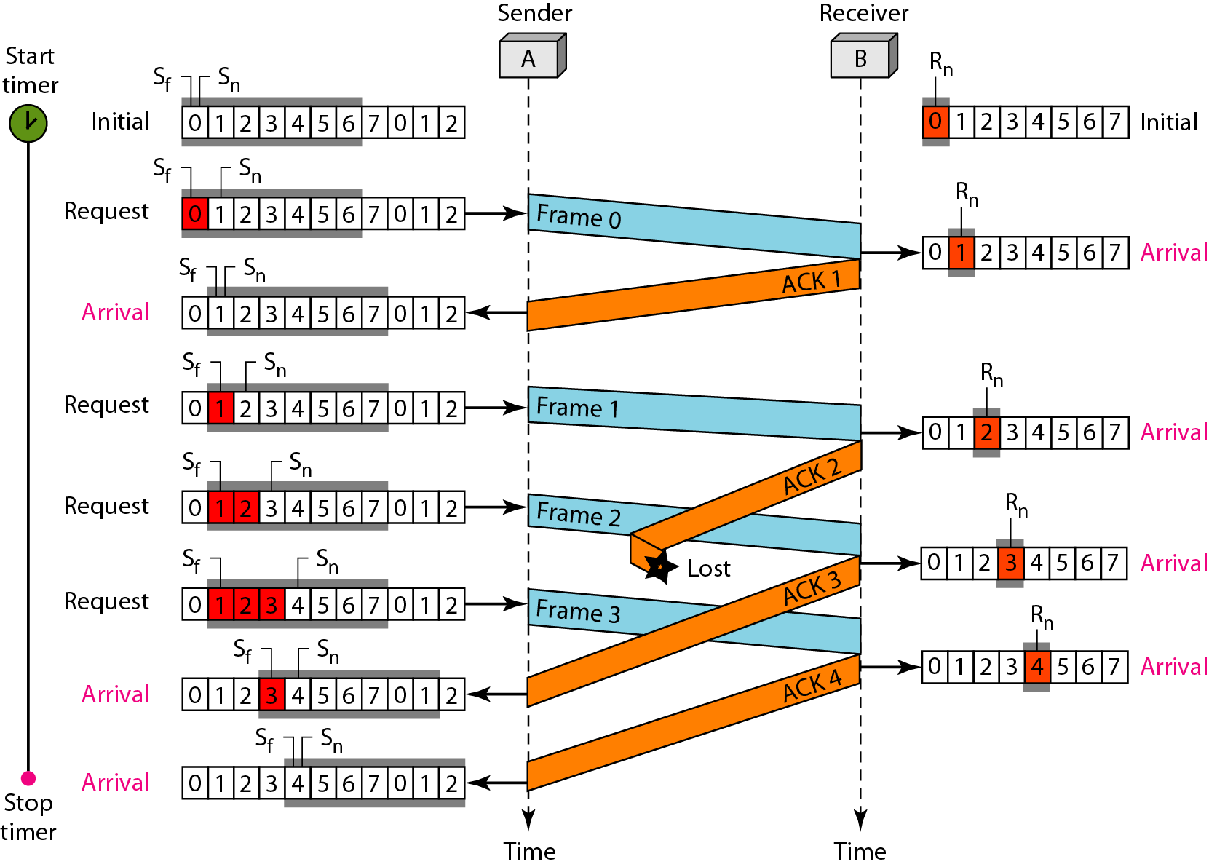
Go-Back-N ARQ
Figure 11.16 Flow diagram for Example 11.6

Slide 54
Go-Back-N ARQ
Example 11.7
Figure 11.17 shows what happens when a frame is lost. Frames 0, 1, 2, and 3 are sent. However, frame 1 is lost. The receiver receives frames 2 and 3, but they are discarded because they are received out of order. The sender receives no acknowledgment about frames 1, 2, or 3. Its timer finally expires. The sender sends all outstanding frames (1, 2, and 3) because it does not know what is wrong. Note that the resending of frames 1, 2, and 3 is the response to one single event. When the sender is responding to this event, it cannot accept the triggering of other events. This means that when ACK 2 arrives, the sender is still busy with sending frame 3.
The physical layer must wait until this event is completed and the data link layer goes back to its sleeping state. We have shown a vertical line to indicate the delay. It is the same story with ACK 3; but when ACK 3 arrives, the sender is busy responding to ACK 2. It happens again when ACK 4 arrives. Note that before the second timer expires, all outstanding frames have been sent and the timer is stopped.

Slide 55
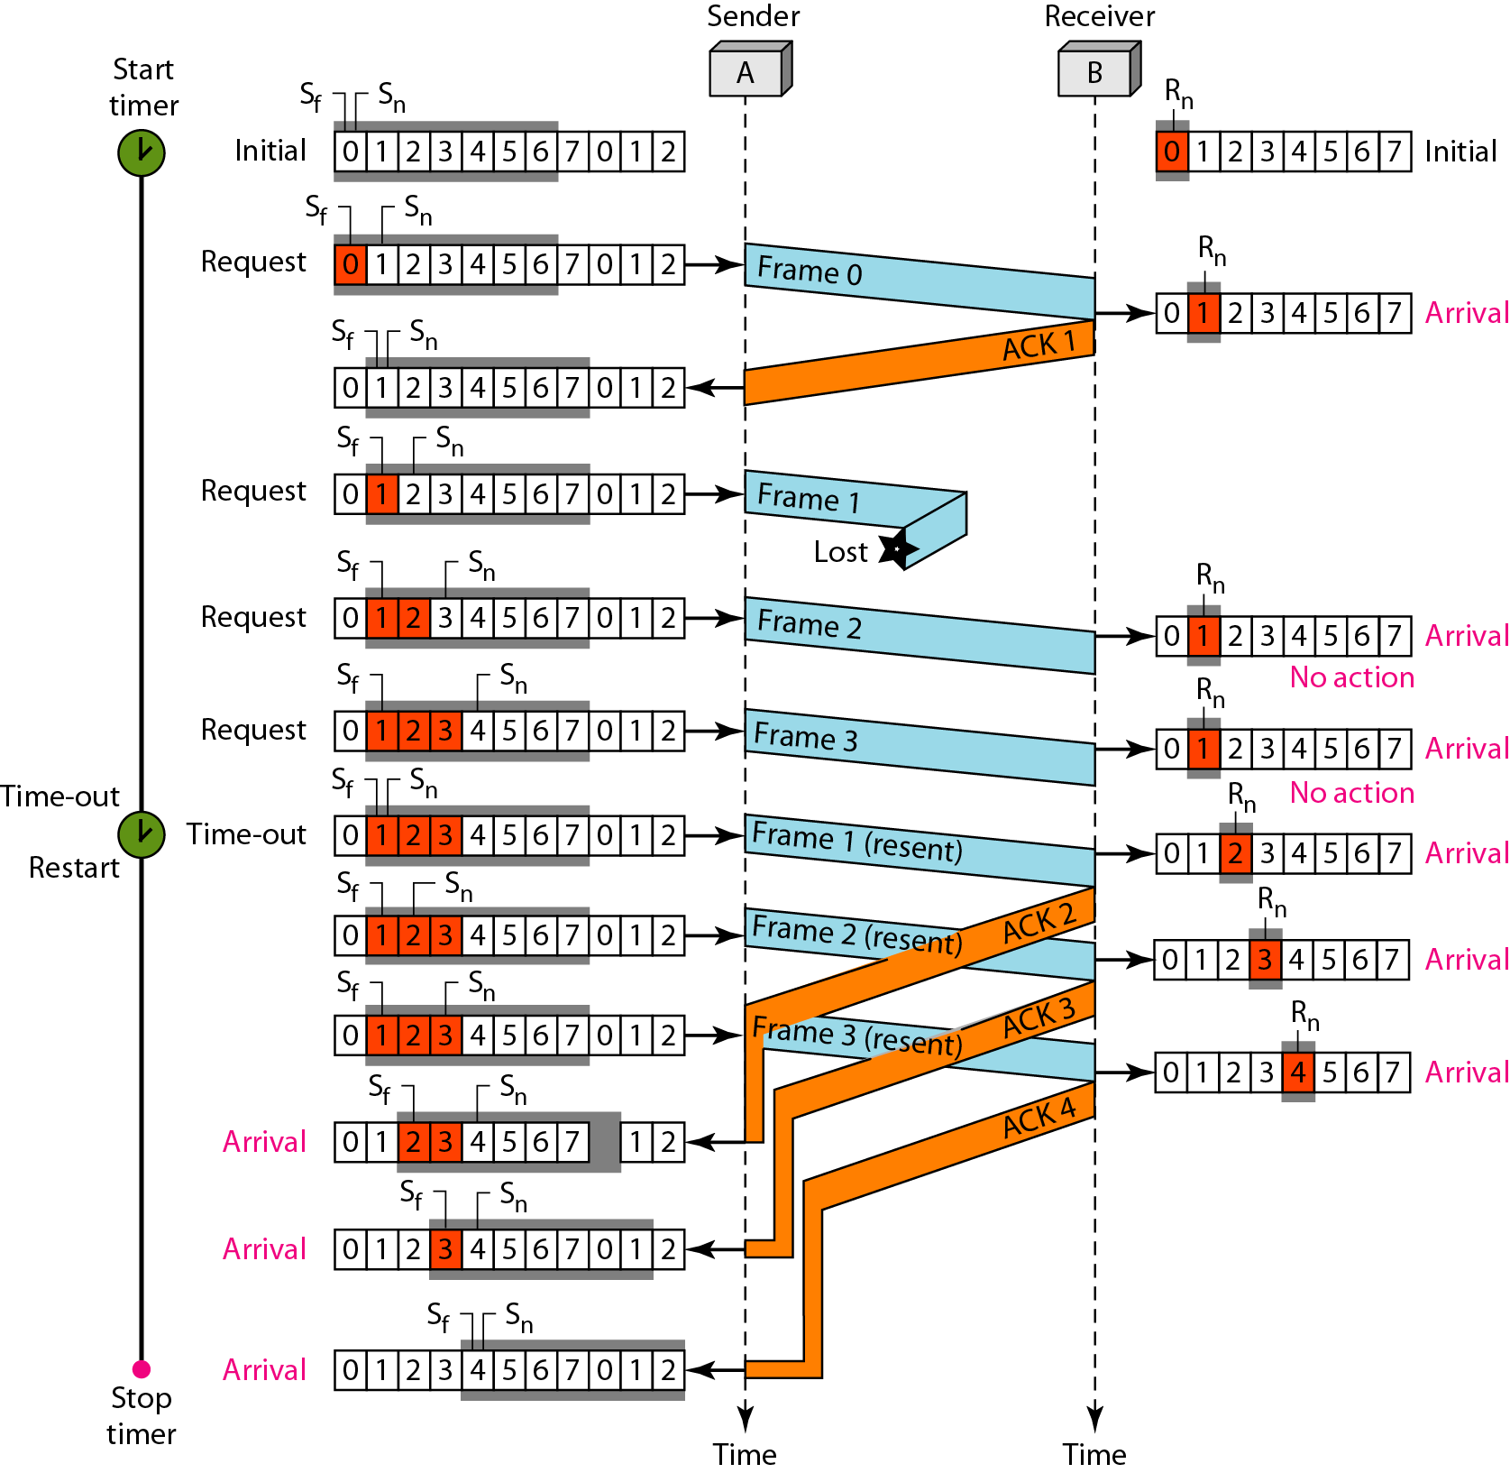
Go-Back-N ARQ
Figure 11.17 Flow diagram for Example 11.7 (4th Ed.)

Slide 56
Go-Back-N ARQ
Note
Stop-and-Wait ARQ is a special case of
Go-Back-N ARQ in which the size of the send window is 1.

Slide 57
Selective-Repeat ARQ
Go-Back-N ARQ is very inefficient for a noisy link
For noisy links, Selective Repeat ARQ does not resend N frames when just one frame is damaged; only the damaged frame is resent.
It is more efficient for noisy links, but the processing at the receiver is more complex.

Slide 58
Selective-Repeat ARQ
The selective Repeat Protocol also uses two windows;
A send window and receive window.
The size of send and receive window are the same and much smaller; it is 2^{m-1}
The Selective Repeat Protocol allows as many frames as the size of the receive window to arrive out of order and be kept until there is a set of in-order frames to be delivered to the network layer.
NAK; negative acknowledgement
If a valid NAK frame arrives, a sender resends the corrresponding frame

Slide 59
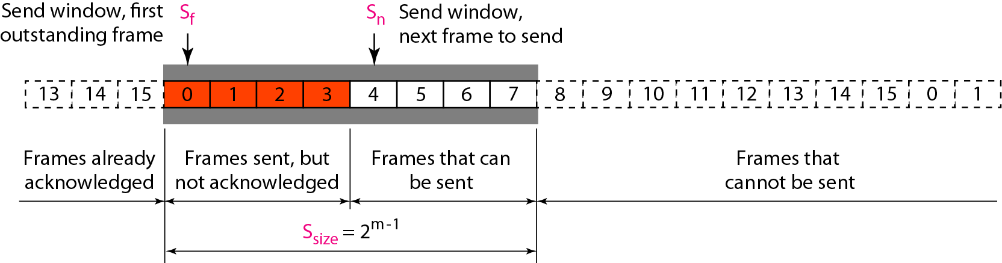
Selective-Repeat ARQ
Figure 11.18 Send window for Selective Repeat ARQ

Slide 60
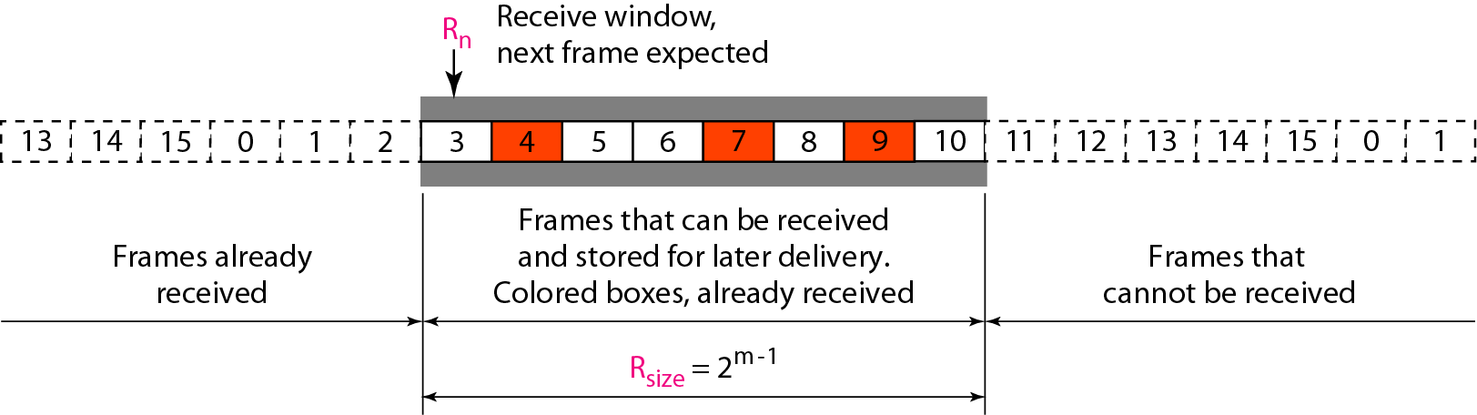
Selective-Repeat ARQ
Figure 11.19 Receive window for Selective Repeat ARQ

Slide 61
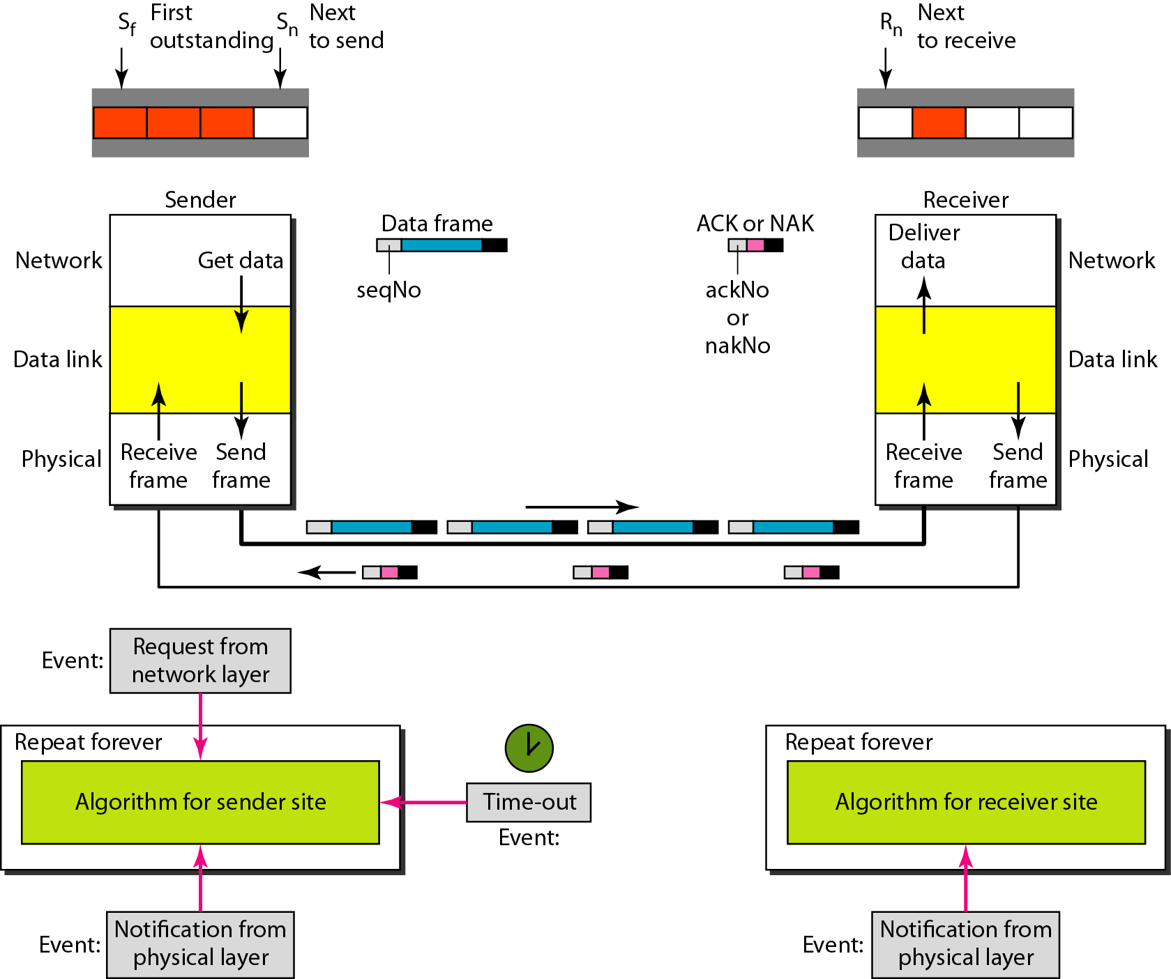
Selective-Repeat ARQ
Figure 11.20 Design of Selective Repeat ARQ

Slide 62
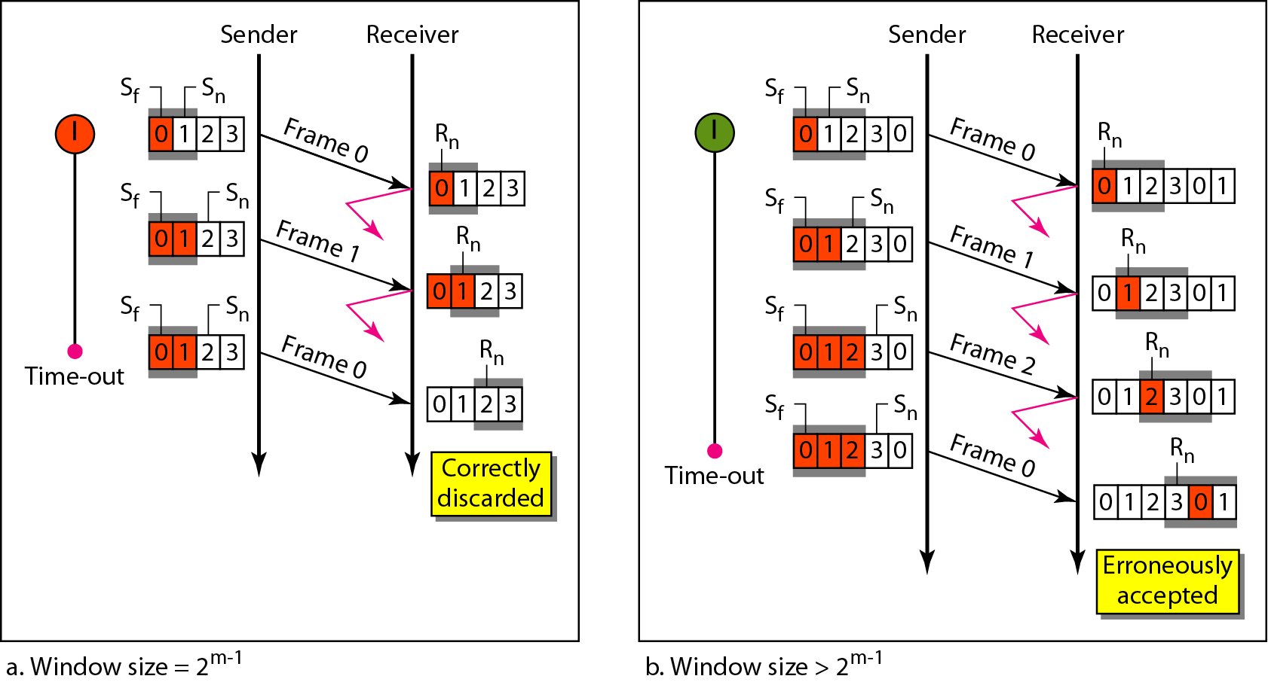
Selective-Repeat ARQ
Figure 11.21 Selective Repeat ARQ, window size
In Selective Repeat ARQ, the size of the sender and receiver window
must be at most one-half of 2^{m}.

Slide 63
Selective-Repeat ARQ
Algorithm 11.9 Sender-site Selective Repeat algorithm
_{(continued)}

Slide 64
Selective-Repeat ARQ
Algorithm 11.9 Sender-site Selective Repeat algorithm
_{(continued)}
_{(continued)}

Slide 65
Selective-Repeat ARQ
Algorithm 11.9 Sender-site Selective Repeat algorithm
_{(continued)}

Slide 66
Selective-Repeat ARQ
Algorithm 11.10 Receiver-site Selective Repeat algorithm

Slide 67
Selective-Repeat ARQ
Algorithm 11.10 Receiver-site Selective Repeat algorithm

Slide 68
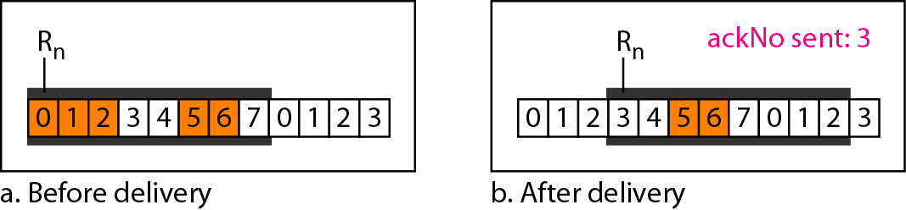
Selective-Repeat ARQ
Figure 11.22 Delivery of data in Selective Repeat ARQ

Slide 69
Selective-Repeat ARQ
Example 11.8
This example is similar to Example 11.3 in which frame 1 is lost. We show how Selective Repeat behaves in this case. Figure 11.23 shows the situation. One main difference is the number of timers. Here, each frame sent or resent needs a timer, which means that the timers need to be numbered (0, 1, 2, and 3). The timer for frame 0 starts at the first request, but stops when the ACK for this frame arrives. The timer for frame 1 starts at the second request, restarts when a NAK arrives, and finally stops when the last ACK arrives. The other two timers start when the corresponding frames are sent and stop at the last arrival event.

Slide 70
Selective-Repeat ARQ
Example 11.8 (continued)
At the receiver site we need to distinguish between the acceptance of a frame and its delivery to the network layer. At the second arrival, frame 2 arrives and is stored and marked, but it cannot be delivered because frame 1 is missing. At the next arrival, frame 3 arrives and is marked and stored, but still none of the frames can be delivered. Only at the last arrival, when finally a copy of frame 1 arrives, can frames 1, 2, and 3 be delivered to the network layer. There are two conditions for the delivery of frames to the network layer: First, a set of consecutive frames must have arrived. Second, the set starts from the beginning of the window.

Slide 71
Selective-Repeat ARQ
Example 11.8 (continued)
Another important point is that a NAK is sent after the second arrival, but not after the third, although both situations look the same. The reason is that the protocol does not want to crowd the network with unnecessary NAKs and unnecessary resent frames. The second NAK would still be NAK1 to inform the sender to resend frame 1 again; this has already been done. The first NAK sent is remembered (using the nakSent variable) and is not sent again until the frame slides. A NAK is sent once for each window position and defines the first slot in the window.

Slide 72
Selective-Repeat ARQ
Example 11.8 (continued)
The next point is about the ACKs. Notice that only two ACKs are sent here. The first one acknowledges only the first frame; the second one acknowledges three frames. In Selective Repeat, ACKs are sent when data are delivered to the network layer. If the data belonging to n frames are delivered in one shot, only one ACK is sent for all of them.

Slide 73
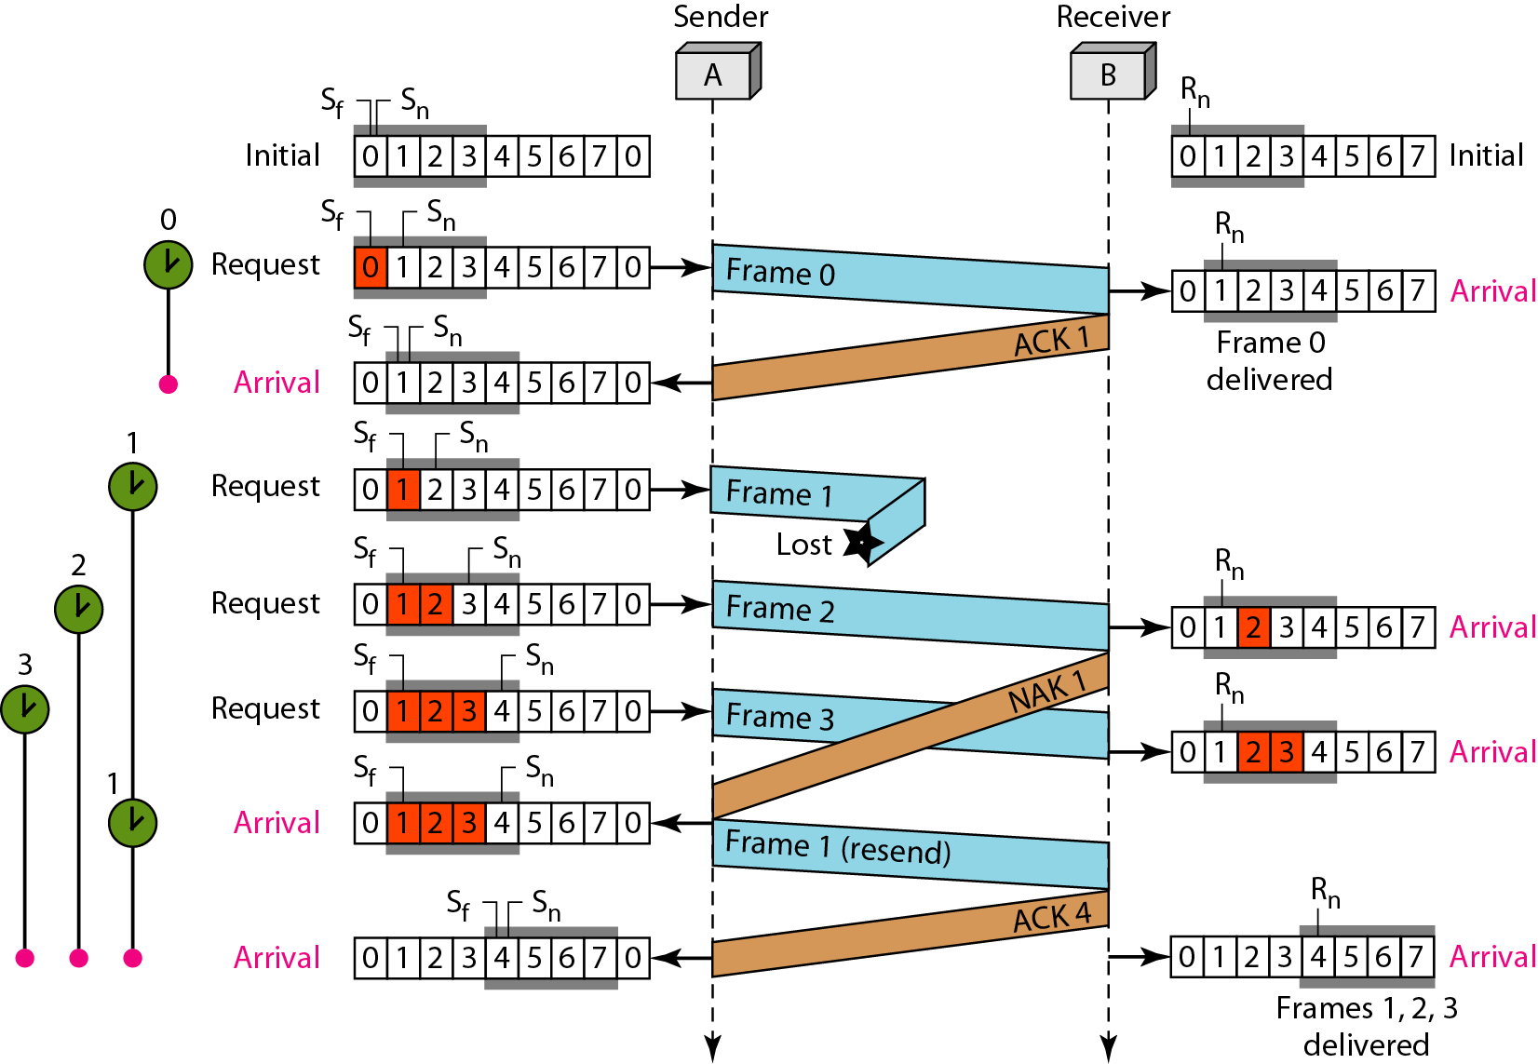
Selective-Repeat ARQ
Figure 11.23 Flow diagram for Example 11.8

Slide 74
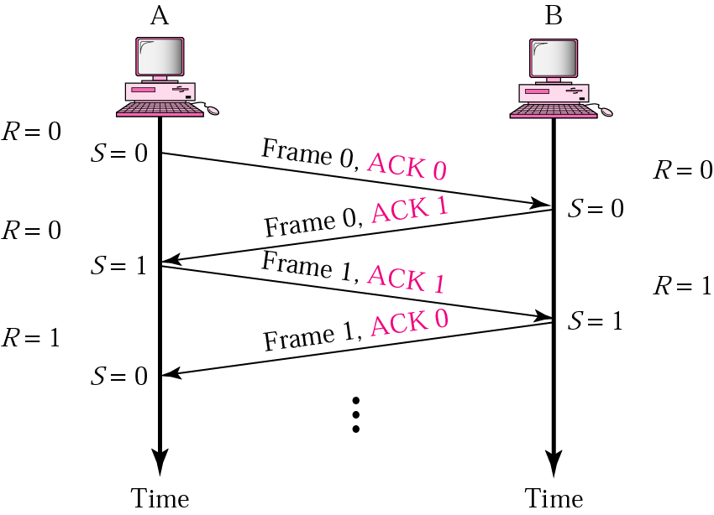
Piggybacking
Piggybacking
meaning combining data to be sent and acknowledgment
of the frame received in one single frame

Slide 75
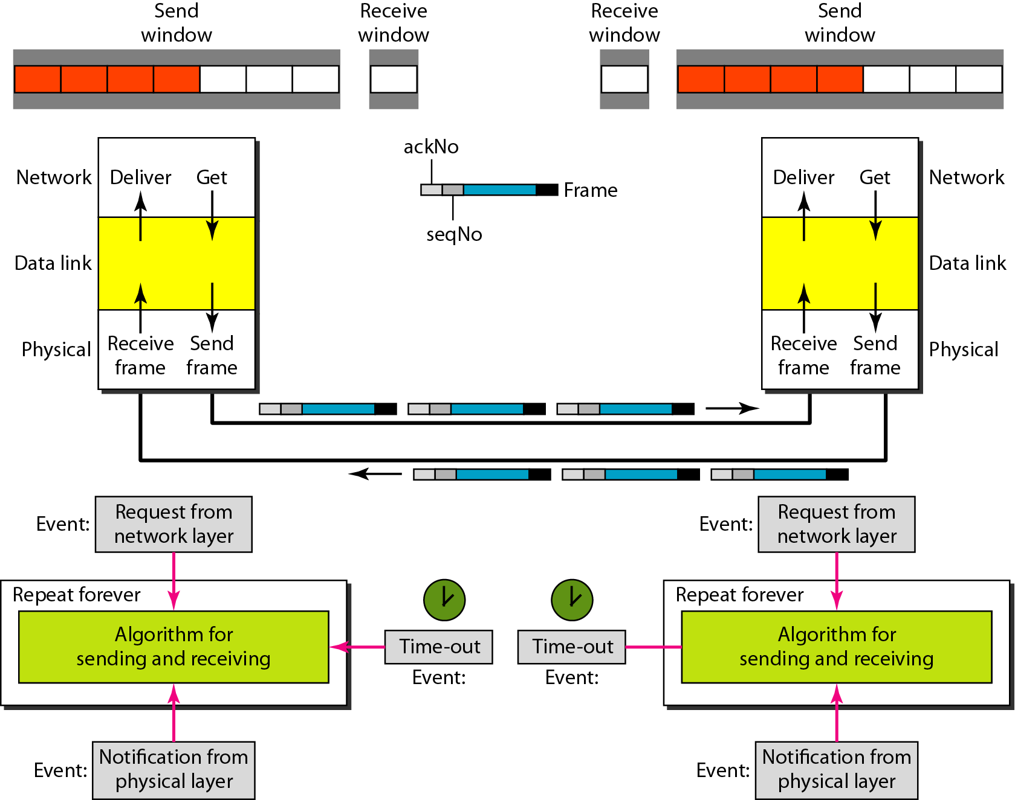
Piggybacking
Figure 11.24 Design of piggybacking in Go-Back-N ARQ

Slide 76
HDLC (High-level Data Link Control)
A mode in HDLC is the relationship between two devices involved in an exchange; The mode of communication describes who controls the link
HDLC supports two modes of communication
between stations
NRM (Normal Response Mode)
ABM (Asynchronous Balanced Mode)

Slide 77
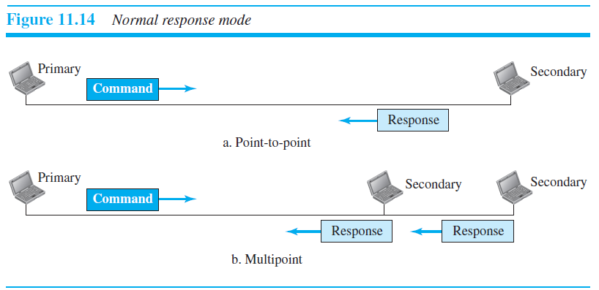
HDLC (cont’d)
NRM (Normal Response Mode)
refers to the standard primary-secondary relationship
secondary device must have permission from the primary device before transmitting

Slide 78
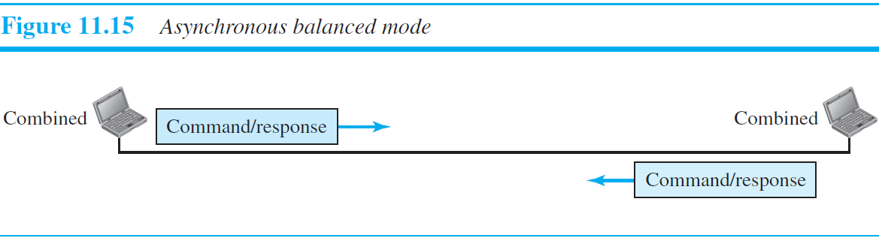
HDLC (cont’d)
ABM (Asynchronous Balanced Mode)
each station can function as a primary and a secondary (acting as peers)

Slide 79
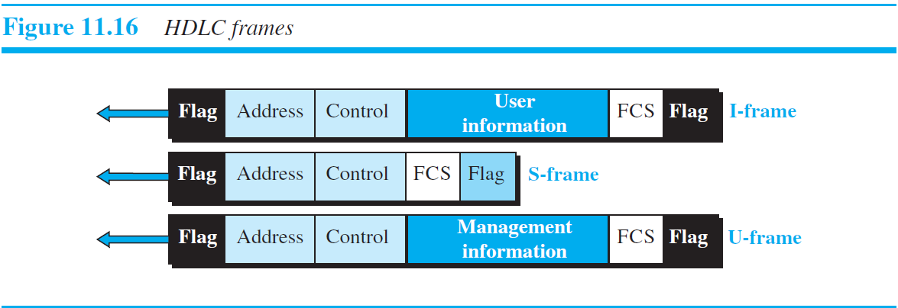
HDLC (cont’d)
HDLC frame

Slide 80
HDLC (cont’d)
HDLC Frame Types
I (Information) Frame
used for user data and control information relating to user data (piggybacking)
S (Supervisory) Frame
used to only to transport control information, primarily data link layer flow and error controls
U (Unnumbered) Frame
is reserved for system management
Information carried by U-frame is intended for managing the link itself

Slide 81
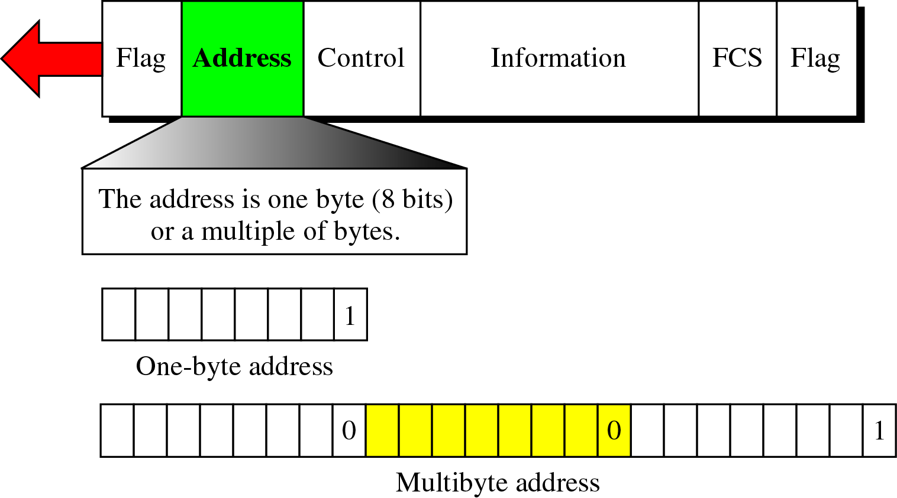
HDLC (cont’d)
Frame may contain up to six fields
Flag field
The flag field is an 8-bit sequence with the bit pattern 01111110 that identifies both the beginning and the end of a frame and serves as a synchronization pattern for the receiver.
Address Field
Address field contains the address of the secondary station that is either the originator or destination of the frame.

Slide 82
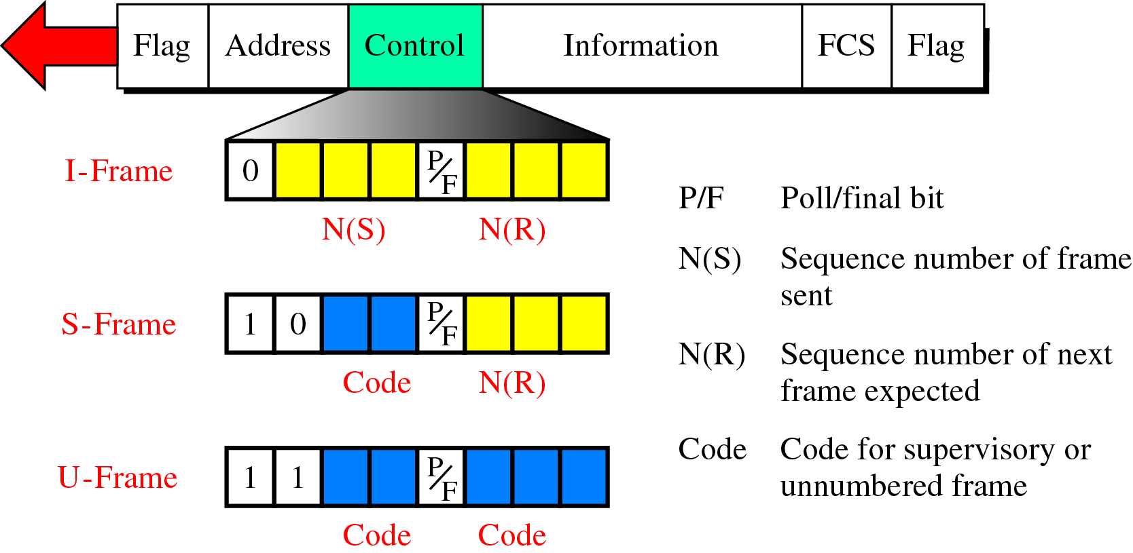
HDLC (cont’d)
Control Field
~ is a 1~2byte segment of the frame used for flow and error control.
The interpretation of bits in this field depends on the frame type.

Slide 83
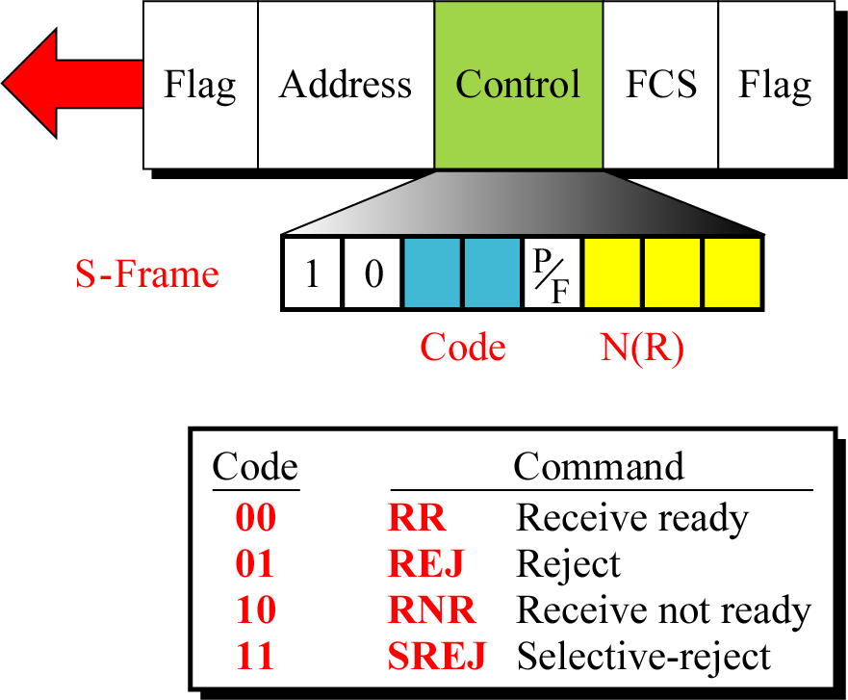
HDLC(cont’d)
Control Field (S-frame)
is used for acknowledgment, flow control, and error control

Slide 84
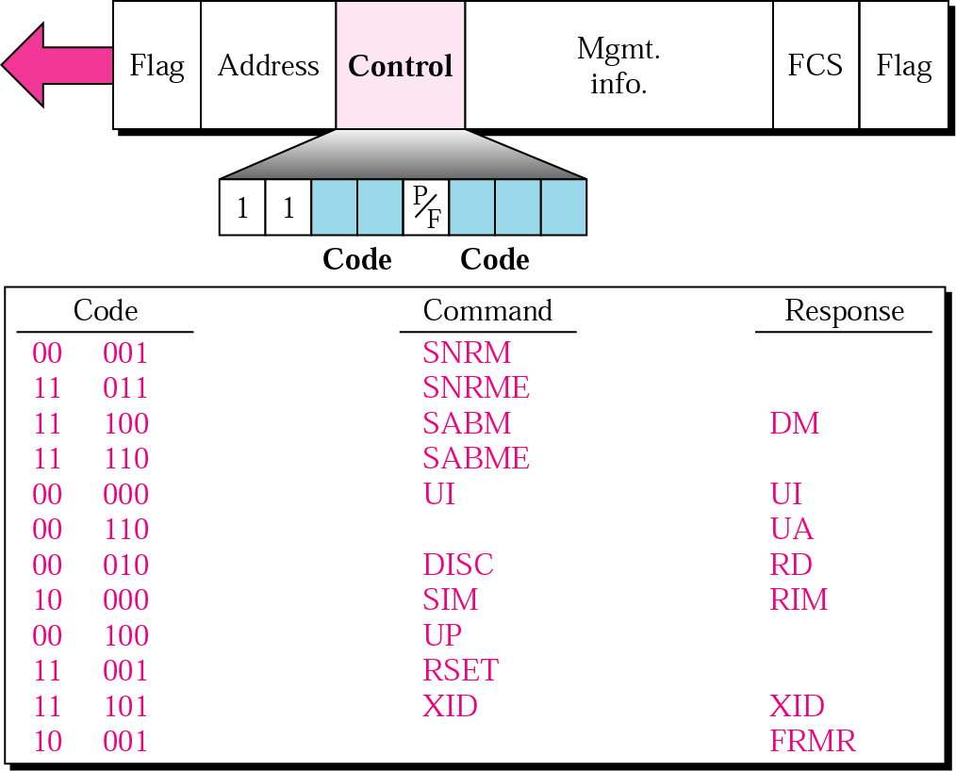
HDLC (cont’d)
Control Field (U-Frame)
is used to exchange session management and control information between connected devices

Slide 85
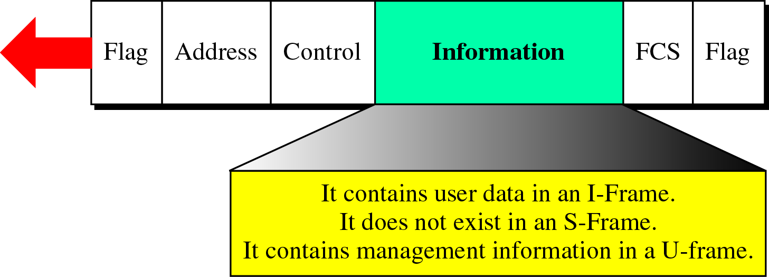
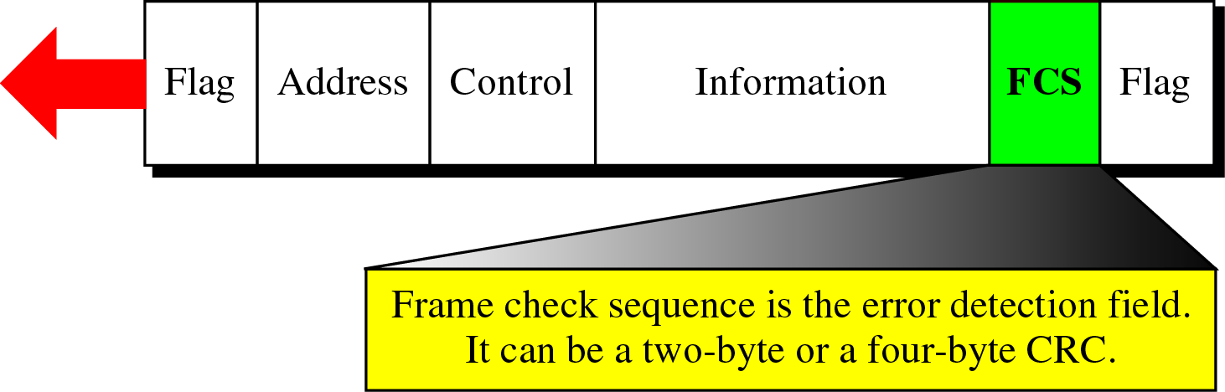
HDLC (cont’d)
Information Field
~ contains the user’s data from the network layer or management information.
FCS (Frame Check Sequence) Field
The frame check sequence is the HDLC error detection field.

Slide 86
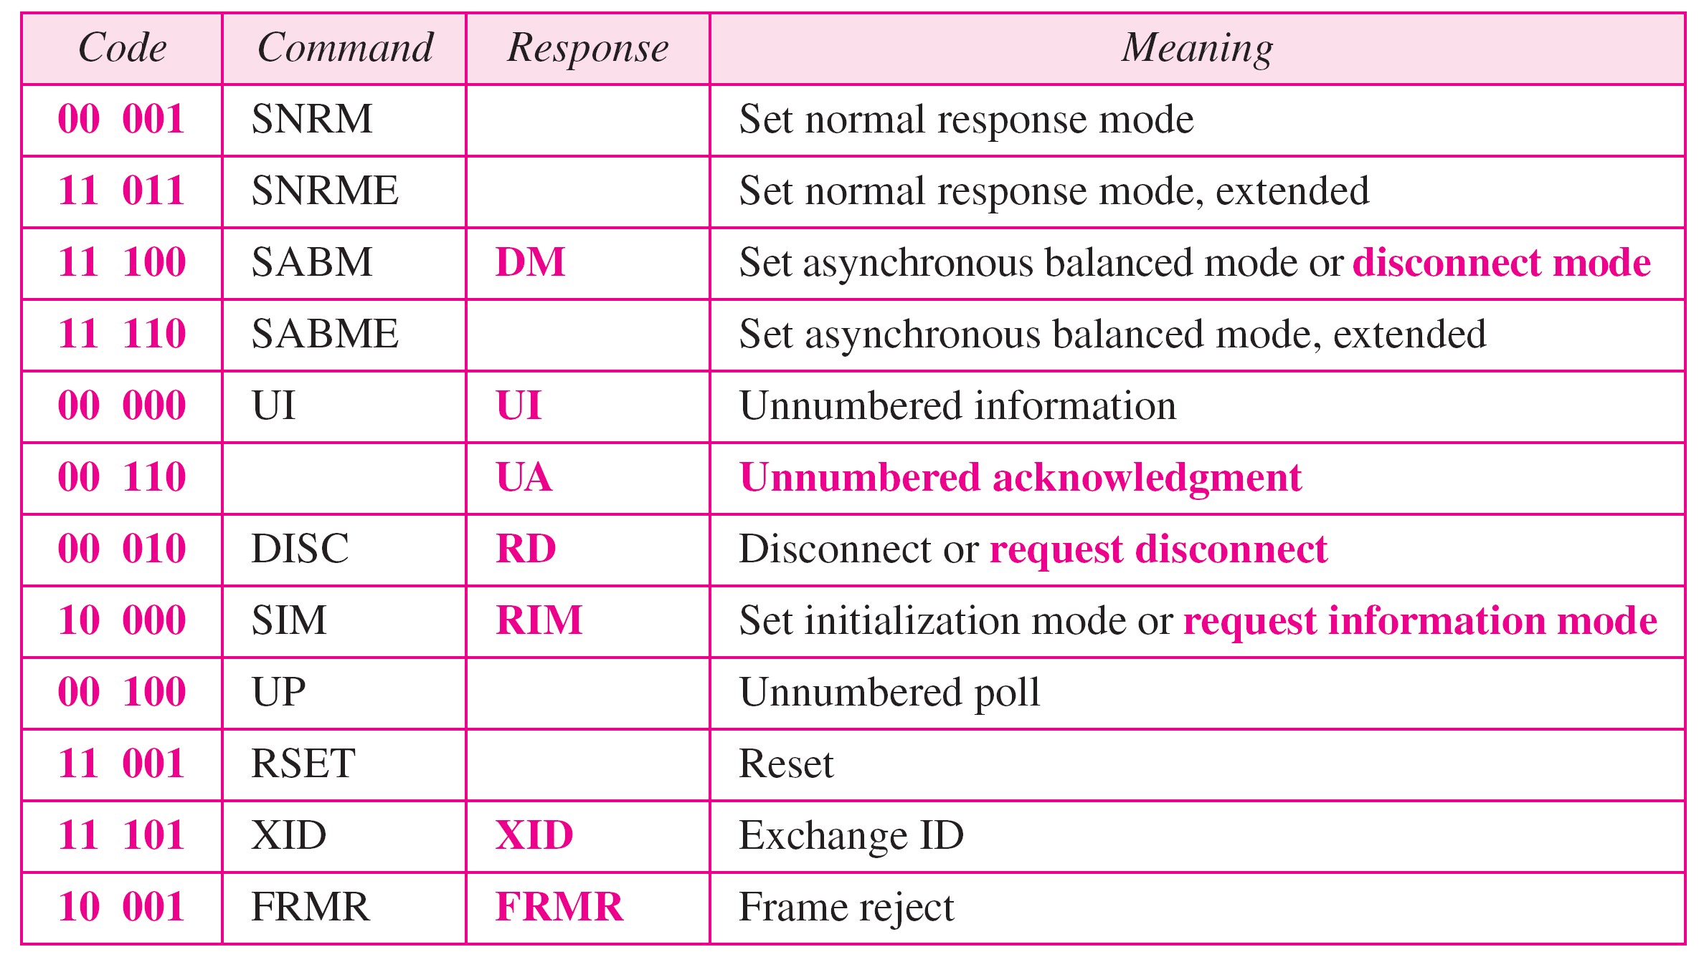
HDLC (cont’d)
Table 11.1 U-frame control command and response

Slide 87
HDLC (cont’d)
Example 11.9
Figure 11.29 shows how U-frames can be used for connection establishment and connection release. Node A asks for a connection with a set asynchronous balanced mode (SABM) frame; node B gives a positive response with an unnumbered acknowledgment (UA) frame. After these two exchanges, data can be transferred between the two nodes (not shown in the figure). After data transfer, node A sends a DISC (disconnect) frame to release the connection; it is confirmed by node B responding with a UA (unnumbered acknowledgment).

Slide 88
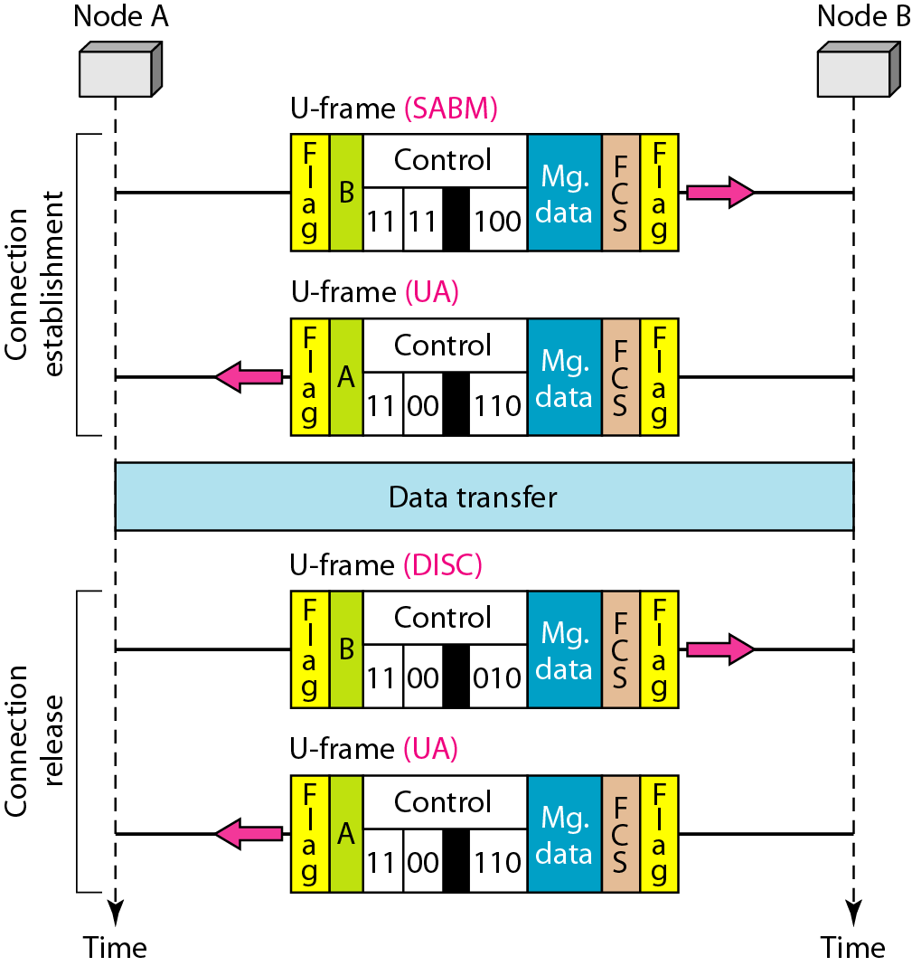
HDLC (cont’s)
Figure 11.29 Example of connection and disconnection

Slide 89
HDLC (cont’d)
Example 11.10
Figure 11.30 shows an exchange using piggybacking. Node A begins the exchange of information with an I-frame numbered 0 followed by another I-frame numbered 1. Node B piggybacks its acknowledgment of both frames onto an I-frame of its own. Node B’s first I-frame is also numbered 0 [N(S) field] and contains a 2 in its N(R) field, acknowledging the receipt of A’s frames 1 and 0 and indicating that it expects frame 2 to arrive next. Node B transmits its second and third I-frames (numbered 1 and 2) before accepting further frames from node A.

Slide 90
HDLC (cont’d)
Example 11.10 (continued)
Its N(R) information, therefore, has not changed: B frames 1 and 2 indicate that node B is still expecting A’s frame 2 to arrive next. Node A has sent all its data. Therefore, it cannot piggyback an acknowledgment onto an I-frame and sends an S-frame instead. The RR code indicates that A is still ready to receive. The number 3 in the N(R) field tells B that frames 0, 1, and 2 have all been accepted and that A is now expecting frame number 3.

Slide 91
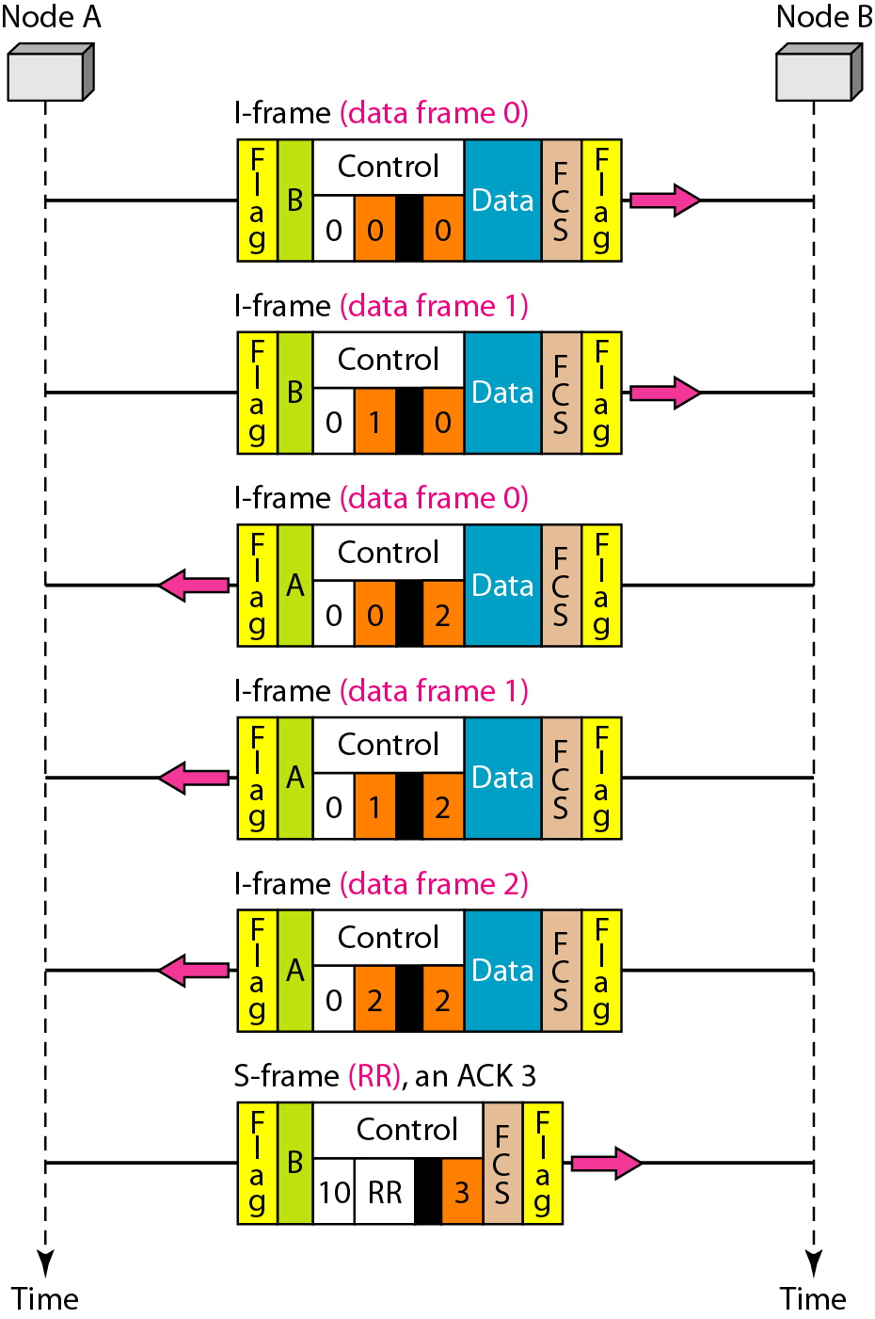
HDLC (cont’d)
Figure 11.30 Example of piggybacking without error

Slide 92
HDLC (cont’d)
Example 11.11
Figure 11.31 shows an exchange in which a frame is lost. Node B sends three data frames (0, 1, and 2), but frame 1 is lost. When node A receives frame 2, it discards it and sends a REJ frame for frame 1. Note that the protocol being used is Go-Back-N with the special use of an REJ frame as a NAK frame. The NAK frame does two things here: It confirms the receipt of frame 0 and declares that frame 1 and any following frames must be resent. Node B, after receiving the REJ frame, resends frames 1 and 2. Node A acknowledges the receipt by sending an RR frame (ACK) with acknowledgment number 3.

Slide 93
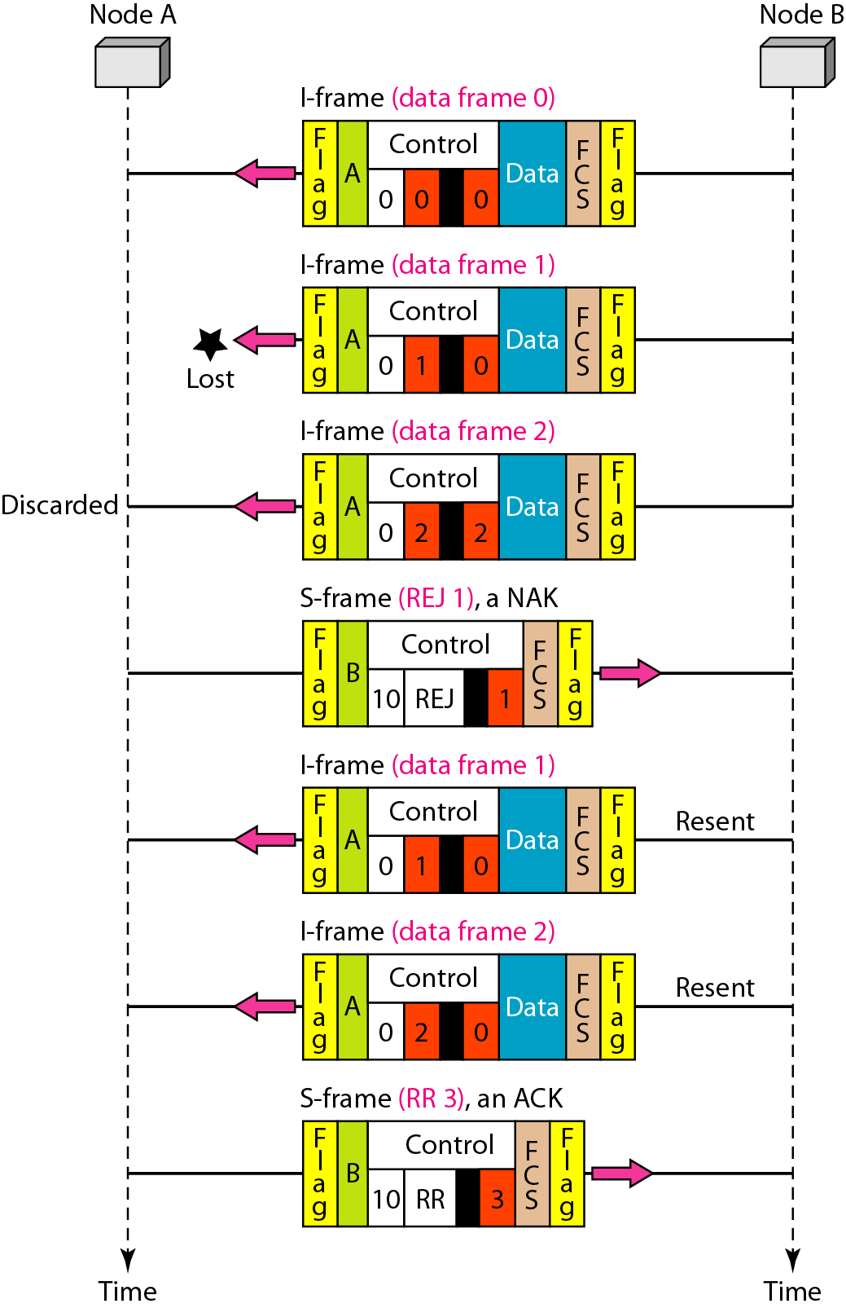
HDLC (cont’d)
Figure 11.31 Example of piggybacking with error

Slide 94
Summary (1)
■ Data link control deals with the design and procedures for communication
between two adjacent nodes: node-to-node communication.
■ Frames can be of fixed or variable size. In fixed-size framing, there is no need
for defining the boundaries of frames; in variable-size framing, we need a
delimiter (flag) to define the boundary of two frames.
■ Variable-size framing uses two categories of protocols: byte-oriented (or
character-oriented) and bit-oriented. In a byte-oriented protocol, the data
section of a frame is a sequence of bytes; in a bit-oriented protocol, the data
section of a frame is a sequence of bits.
■ In byte-oriented (or character-oriented) protocols, we use byte stuffing; a special
byte added to the data section of the frame when there is a character with the
same pattern as the flag.
■ In bit-oriented protocols, we use bit stuffing; an extra 0 is added to the data
section of the frame when there is a sequence of bits with the same pattern as
the flag.
■ Flow control refers to a set of procedures used to restrict the amount of data that
the sender can send before waiting for acknowledgment. Error control refers to
methods of error detection and correction.

Slide 95
Summary (2)
■ For the noiseless channel, we discussed two protocols: the Simplest
Protocol and the Stop-and-Wait Protocol.
■ For the noisy channel, we discussed three protocols: Stop-and-Wait ARQ,
Go-Back-N, and Selective Repeat ARQ.
■ Both Go-Back-N, and Selective-Repeat Protocols use a sliding window.
■ A technique called piggybacking is used to improve the efficiency of the
bidirectional protocols.
■ High-level Data Link Control (HDLC) is a bit-oriented protocol for
communication over point-to-point and multipoint links. However, the most
common protocols for point-to-point access is the Point-to-Point Protocol
(PPP), which is a byte-oriented protocol.

Slide 98
Q and A

